Slide 1
Meeting Coal Authority
Mylene Receveur
16/01/2020
Ian Watson, Christopher McDermott, Andrew Fraser Harris

Slide 2
Shafts

Slide 3
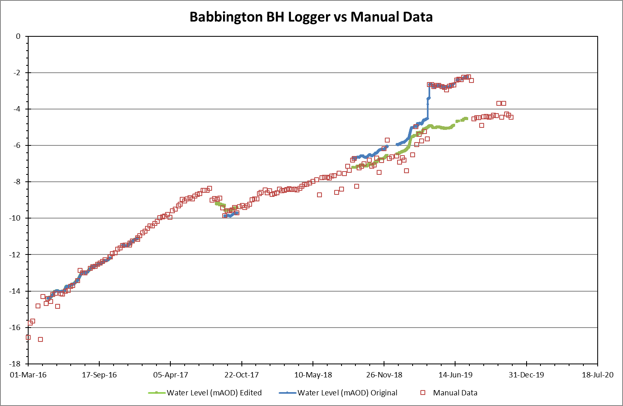
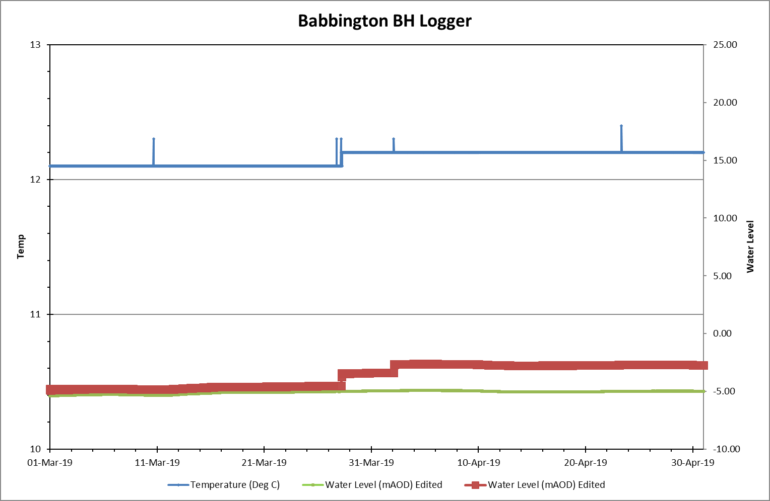
Babbington

Slide 4
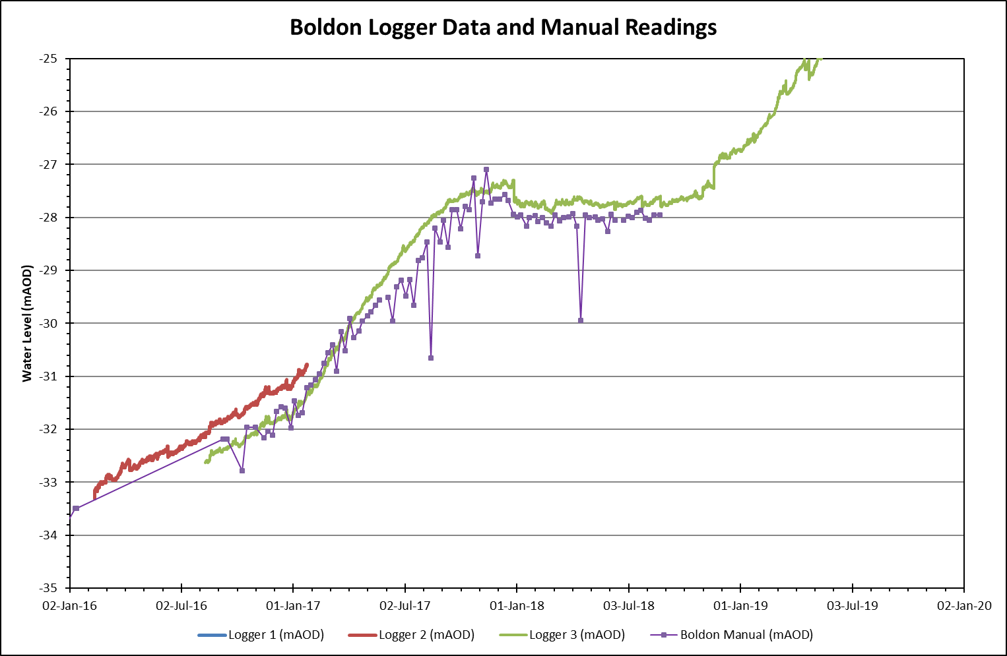
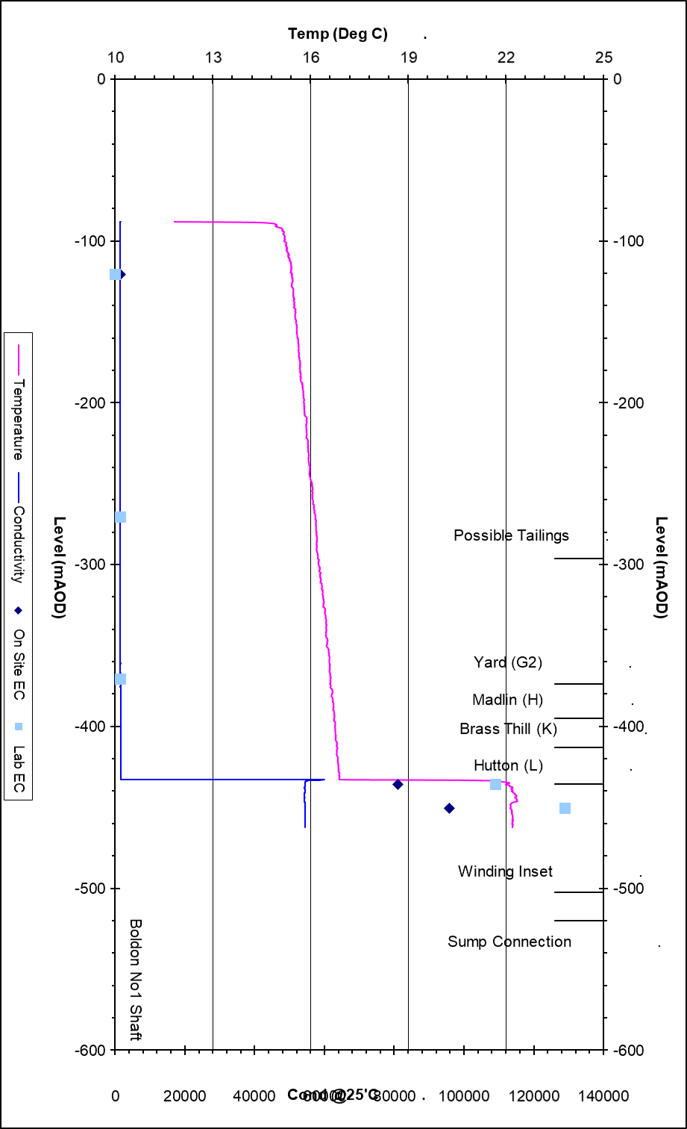
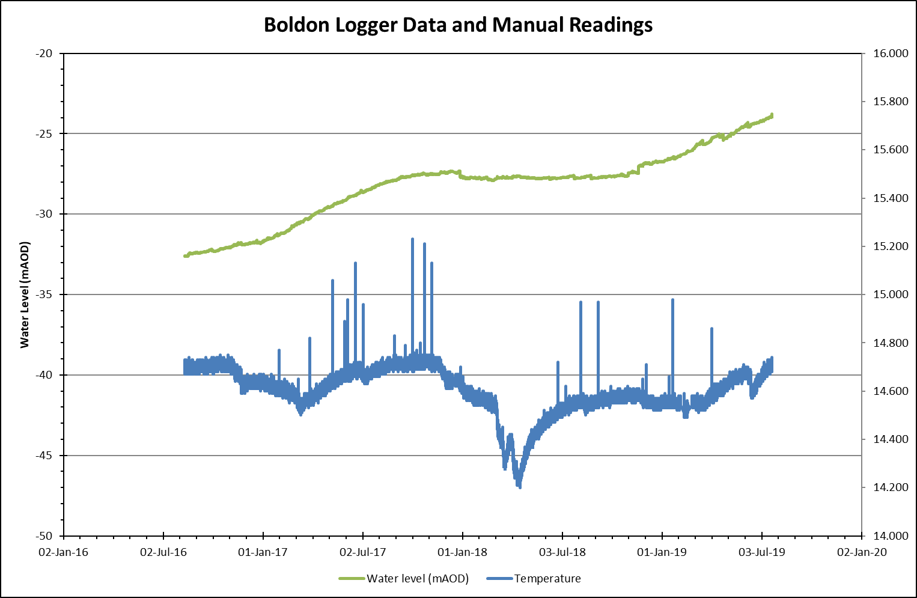
Boldon

Slide 5
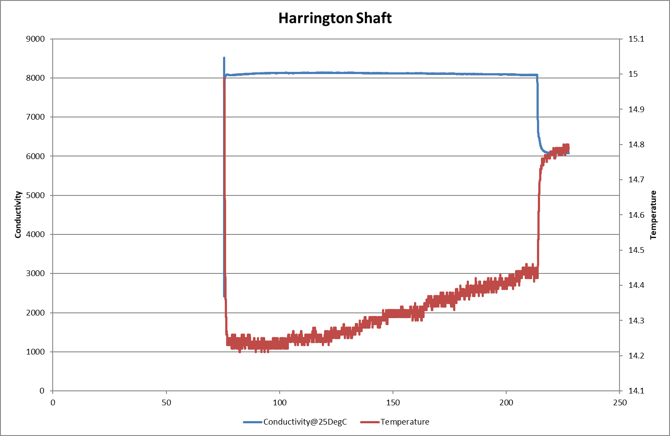
Hartington shaft – ECT LOG

Slide 6
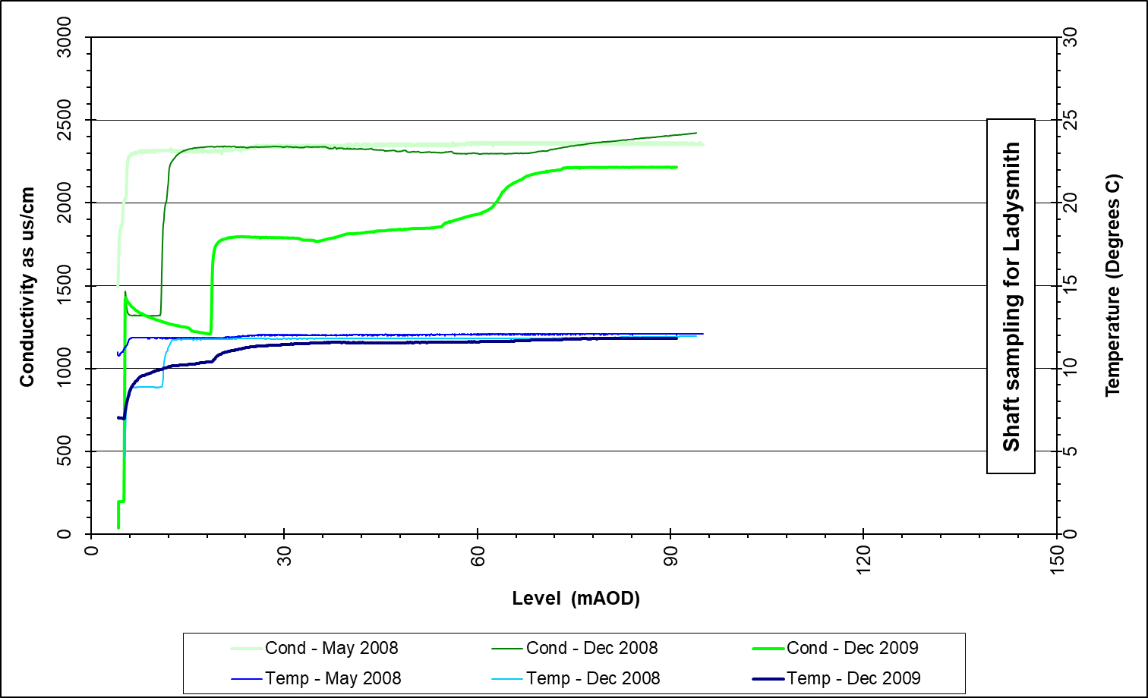
Ladysmith

Slide 7
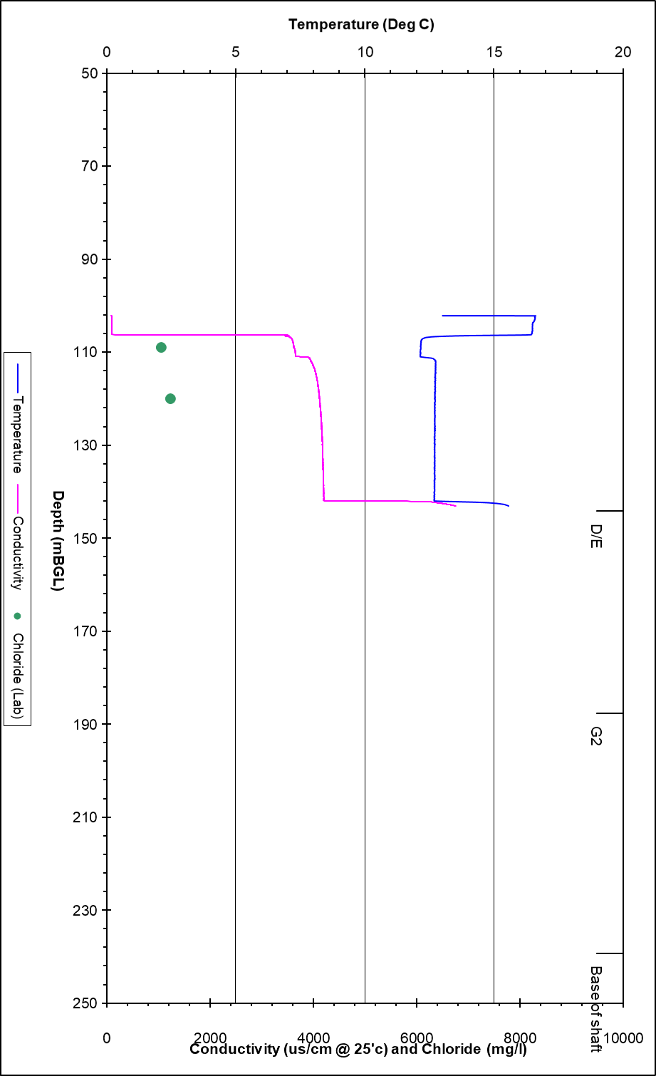
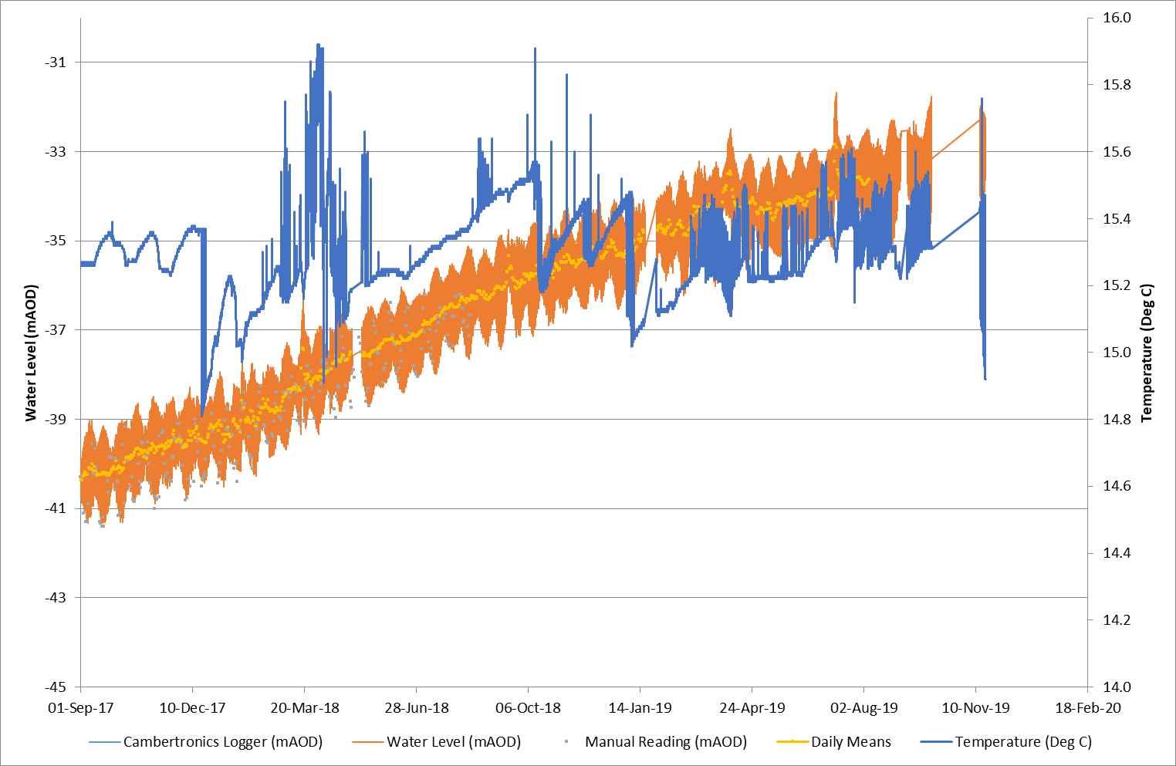
Lynemouth

Slide 8
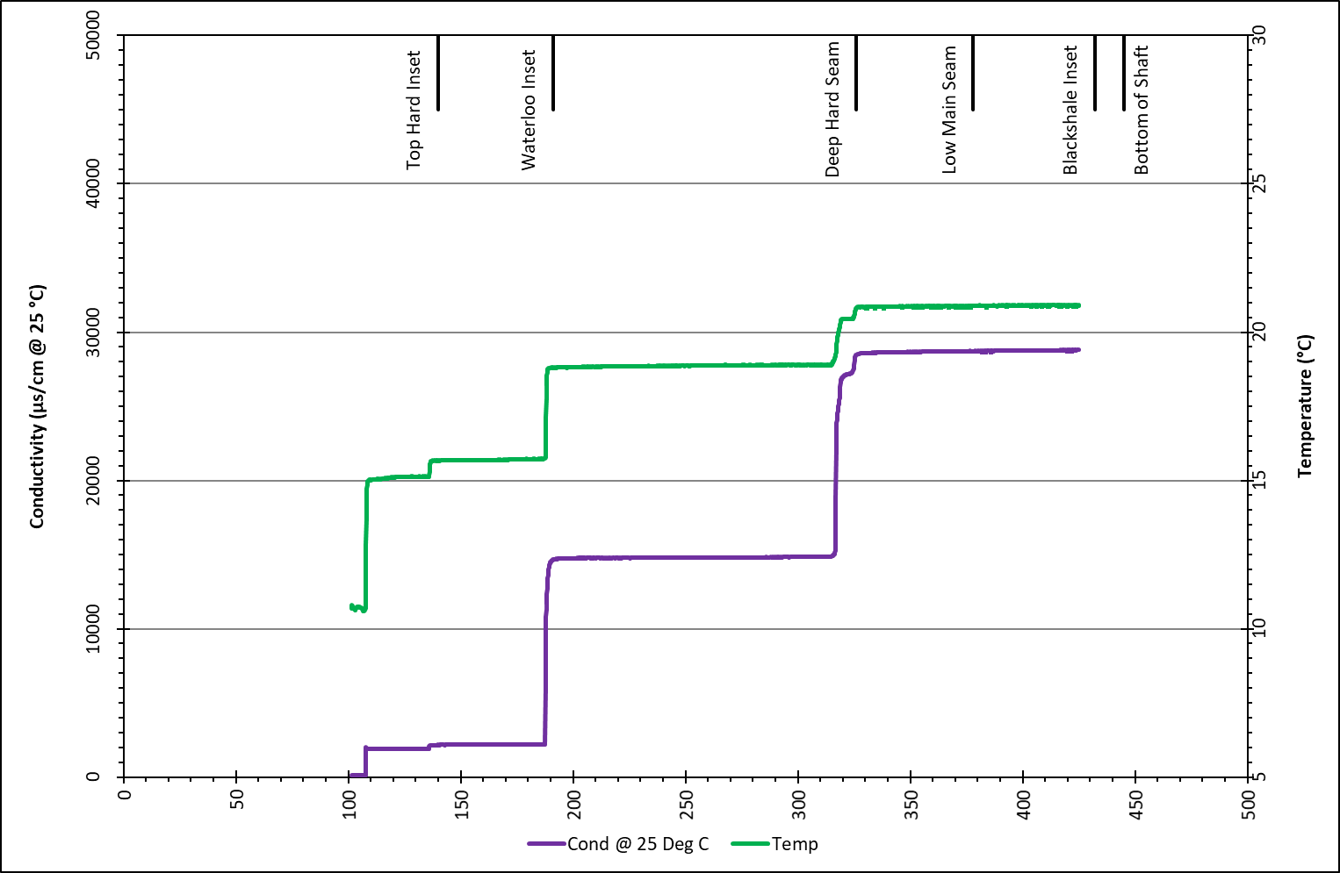
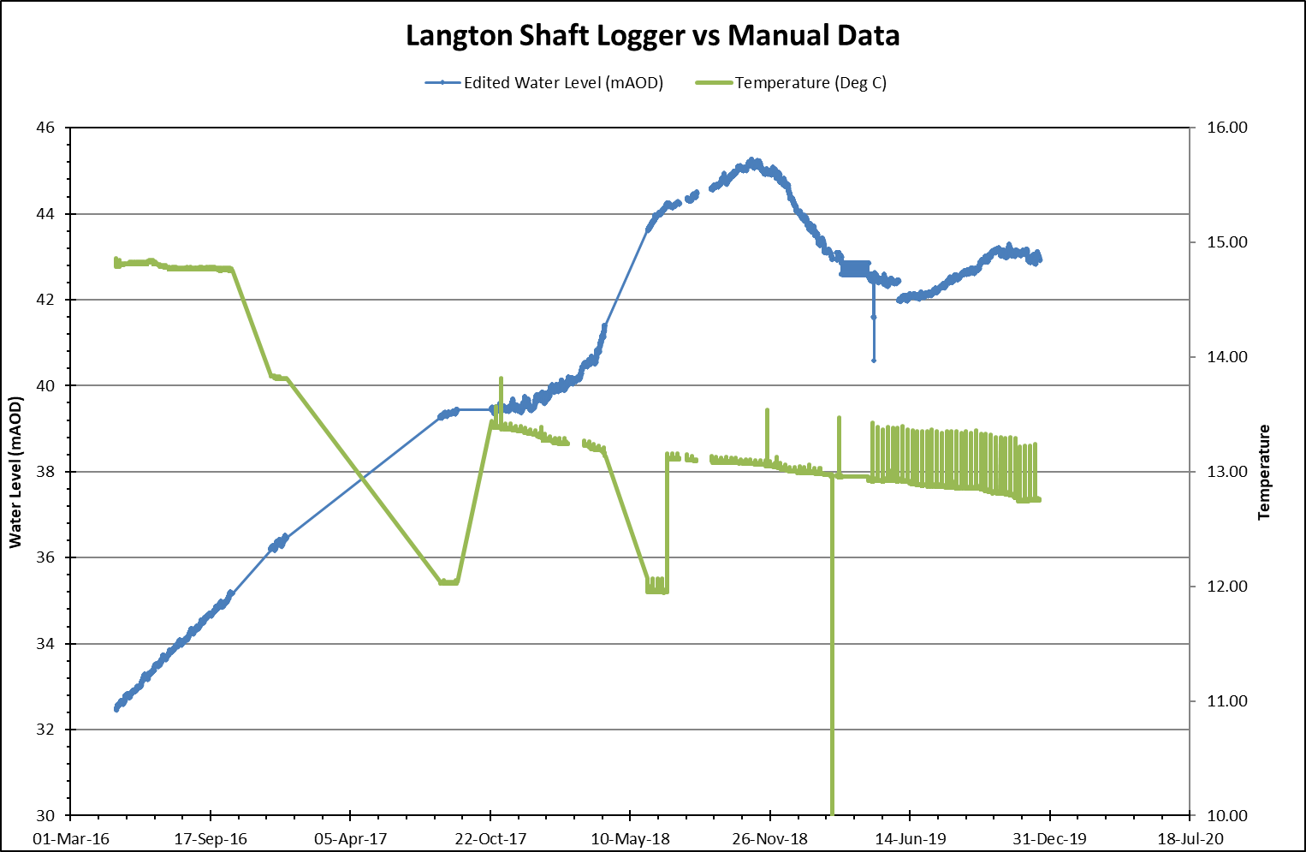
Langton No7 shaft ECT Log 2013 Water Level LOG

Slide 9
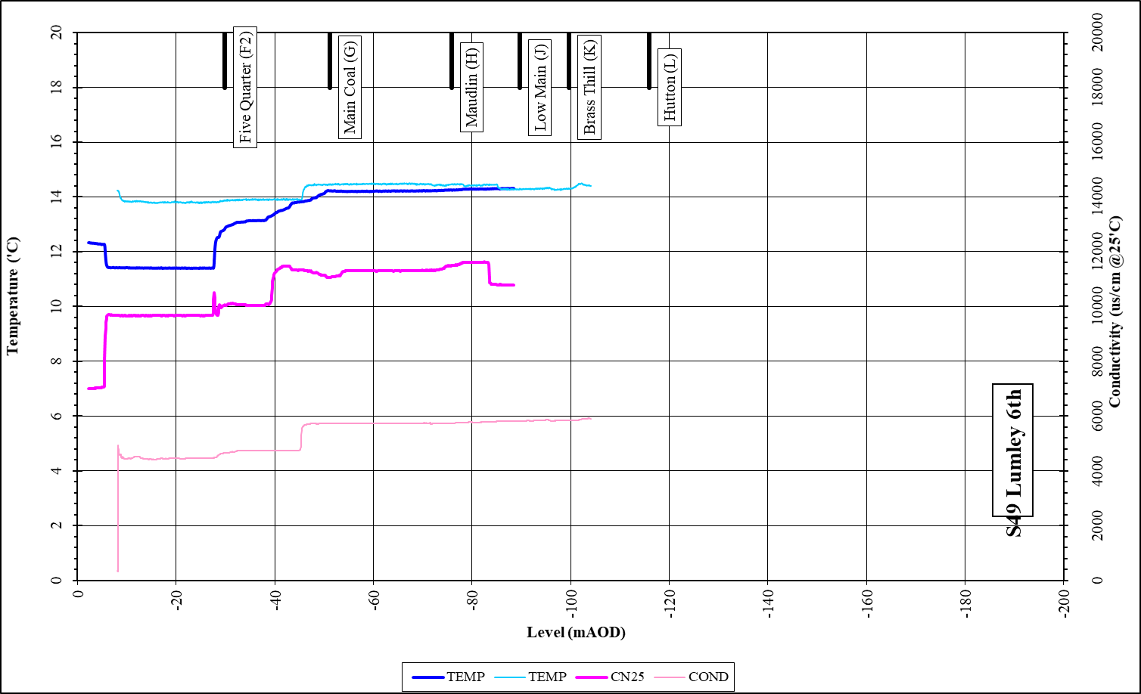
Lumley 6th shaft

Slide 10
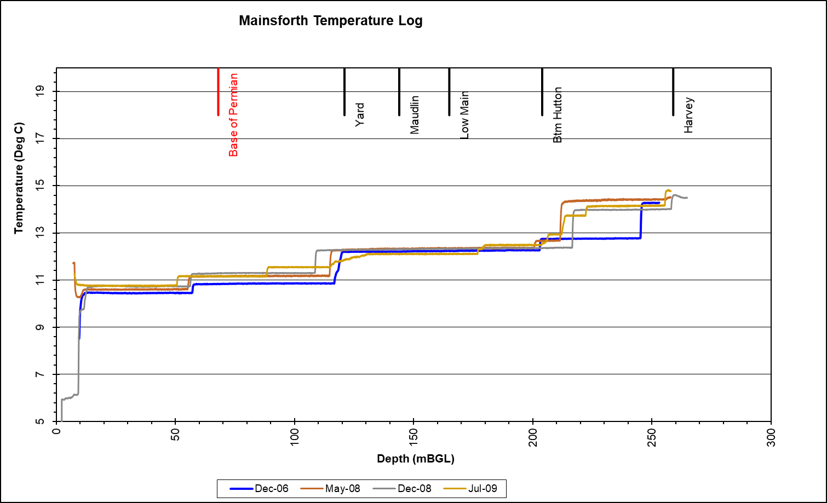
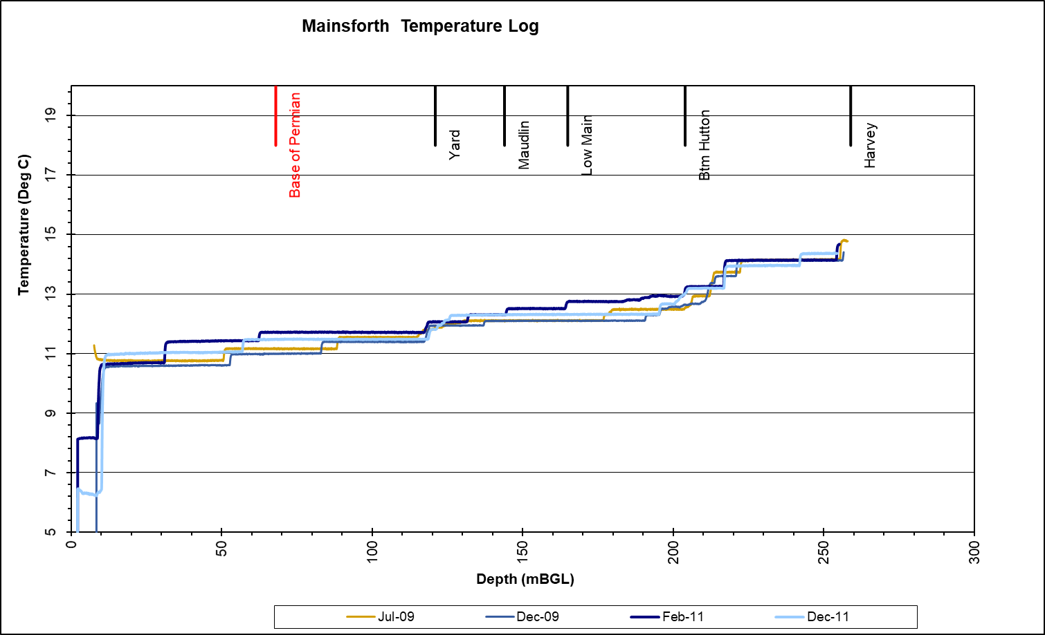
Mainsforth
mine flooded for > 25 years (recovered in late 70's)
EC-T logs for study of seasonal variability in chemistry

Slide 11
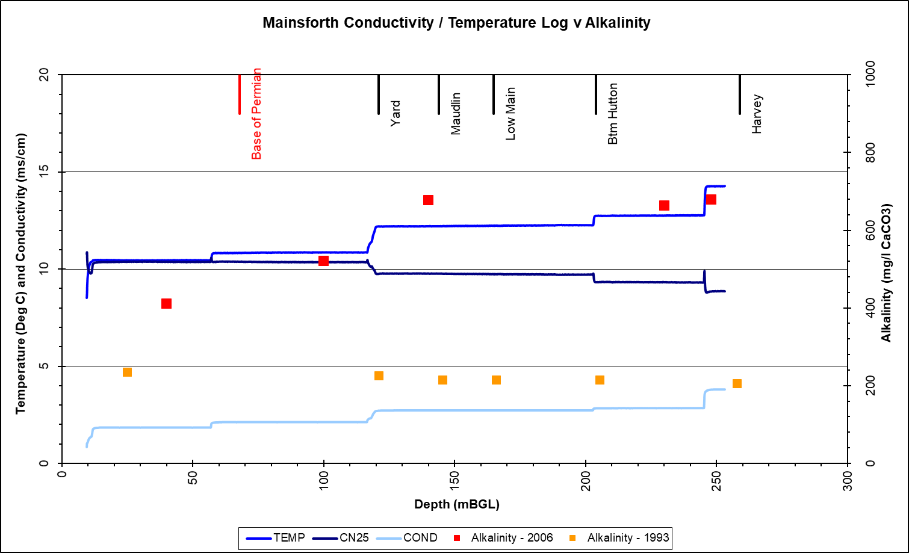
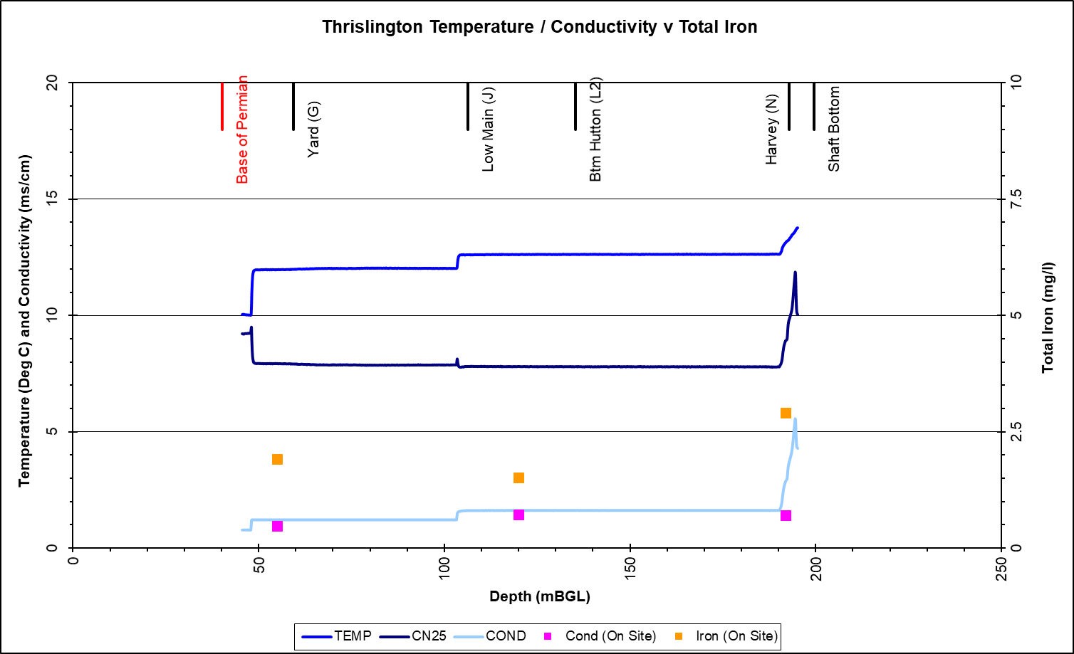
Mainsforth / Thrislington

Slide 12
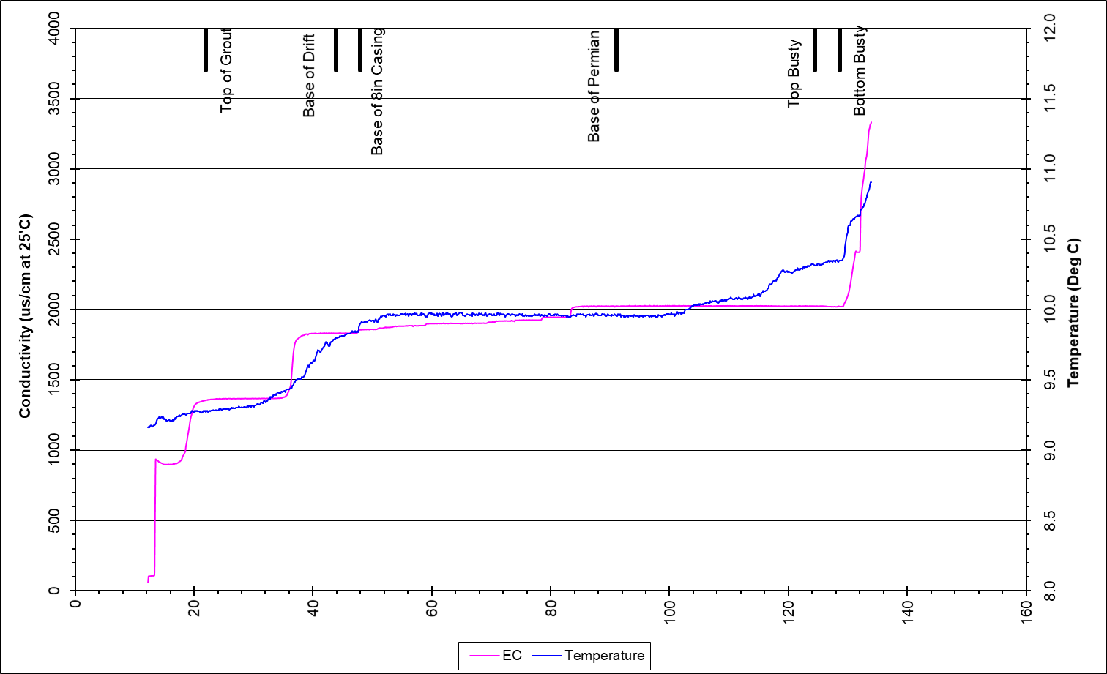
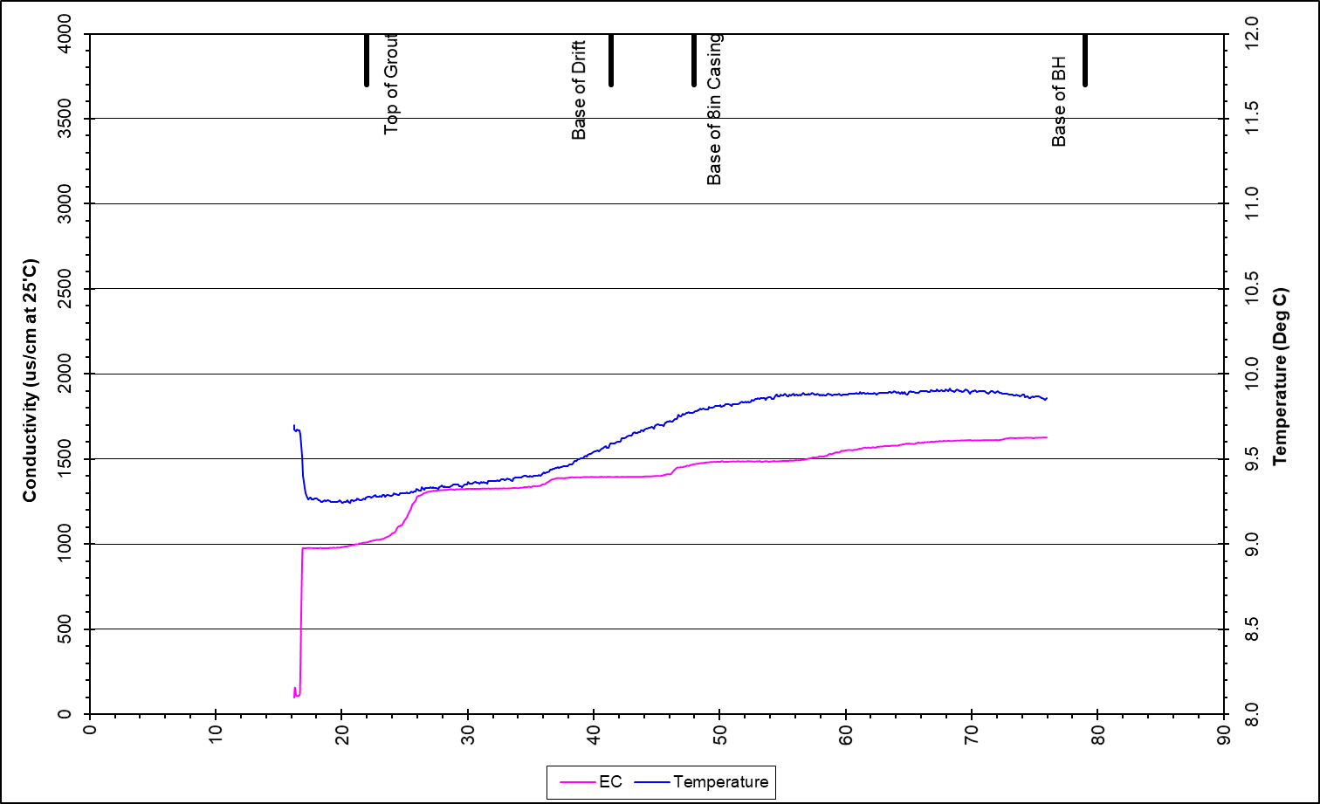
Stony Hall CM / Mag Lst

Slide 13
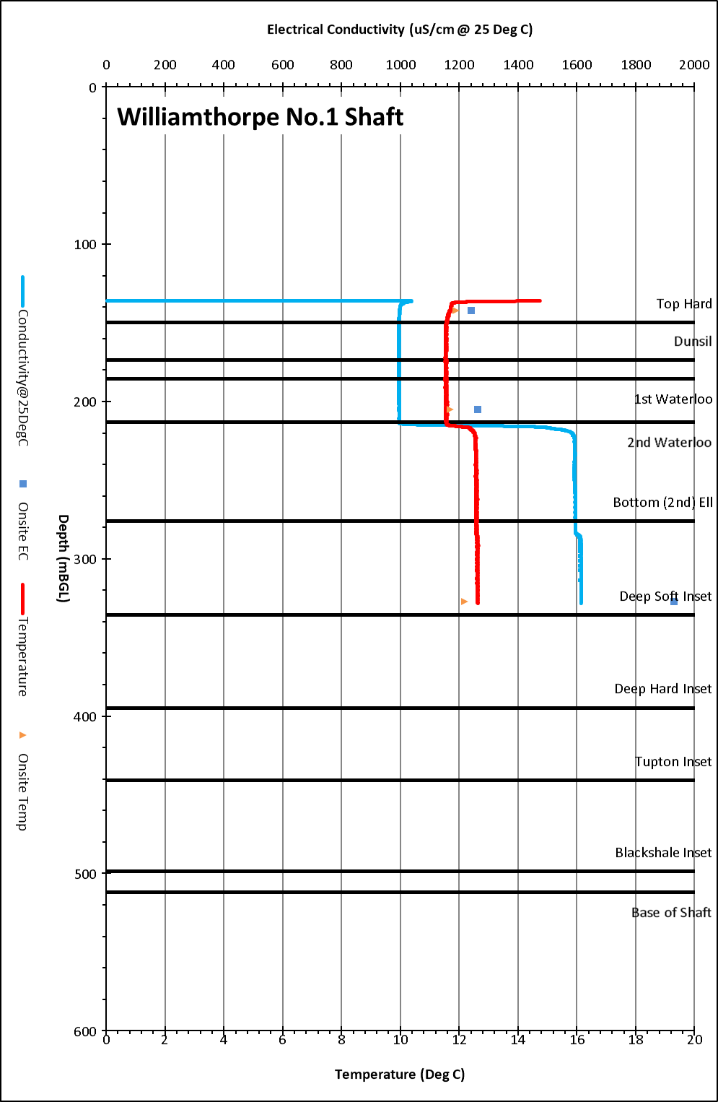
Williamthorpe Shaft ECT Log 2017

Slide 14
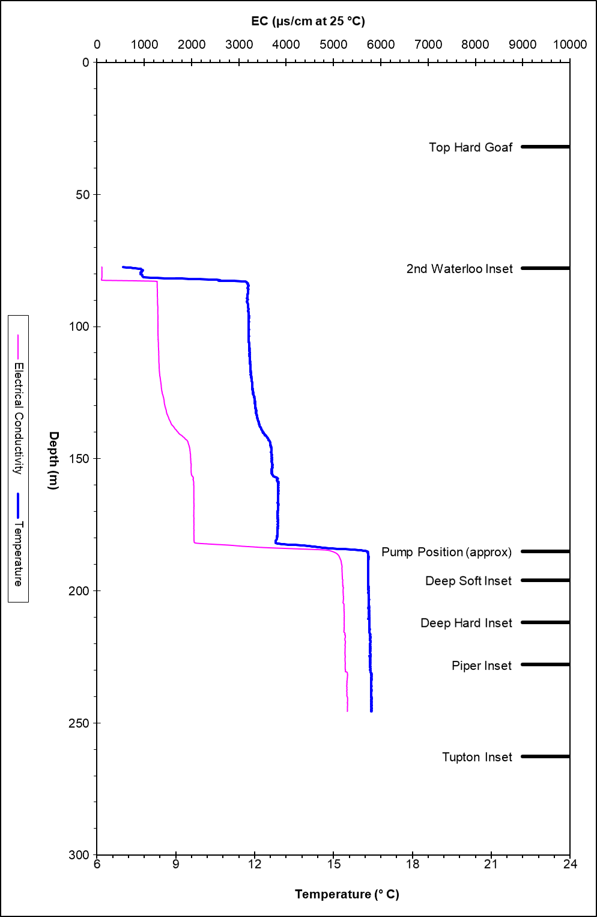
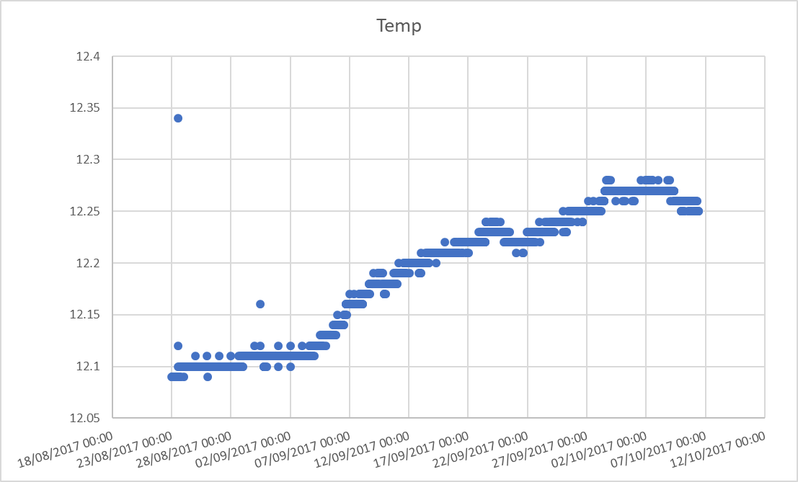
Woodside Logger Data ECT Log 2010

Slide 15
Borehole
Missing Logger data:
Balgone Dalginch
Balgone Muirespot
Missing water level Logger
Balgonie Dalginch BH (monitoring borehole)
Mosside BH (Monitoring BH)
Rigside (Monitoring BH)
Pumping test
Cadley Hill BH
ECT Log
Leacroft (Monitoring BH) – 2019
Littleton (Monitoring BH) – 2019
Stony Heap – 2009
West Cannock No5 Aquifer and Seam BH - 2019
On-site testing
Tollcross Burn (Monitoring BH)

Slide 16
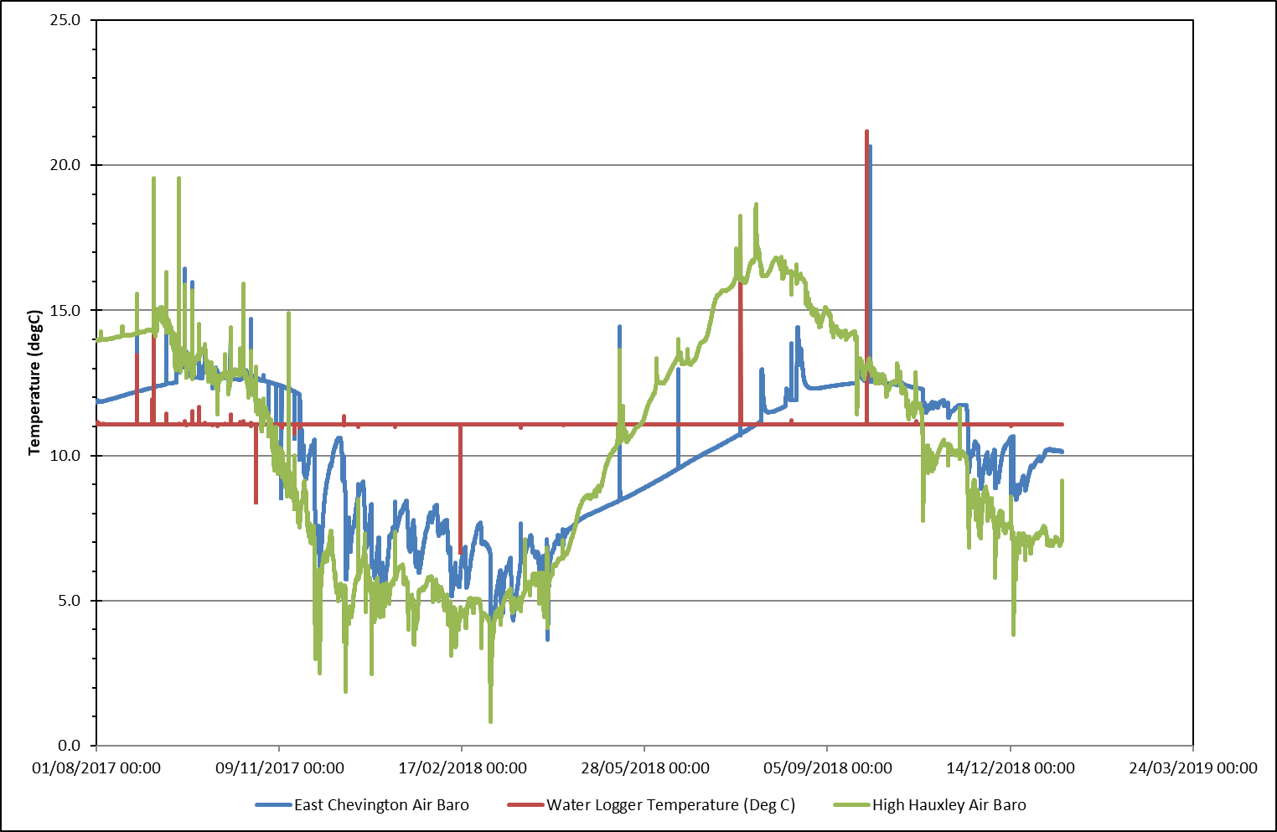
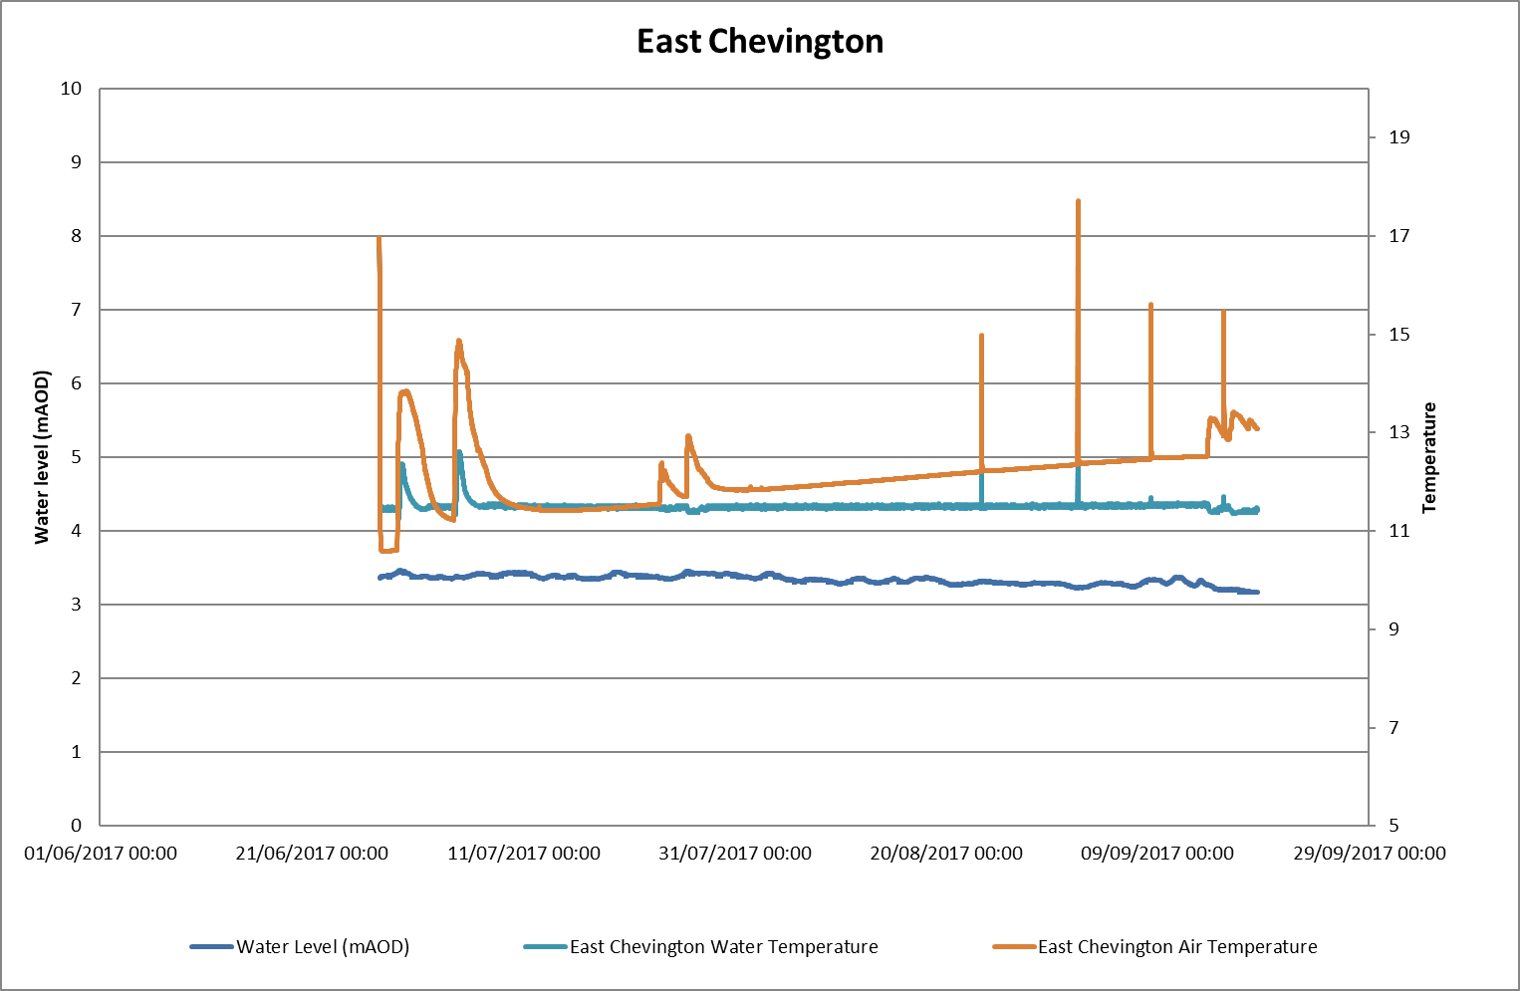
Broomhill – Water Level Log + East Chevington / High Hauxley Baro

Slide 17
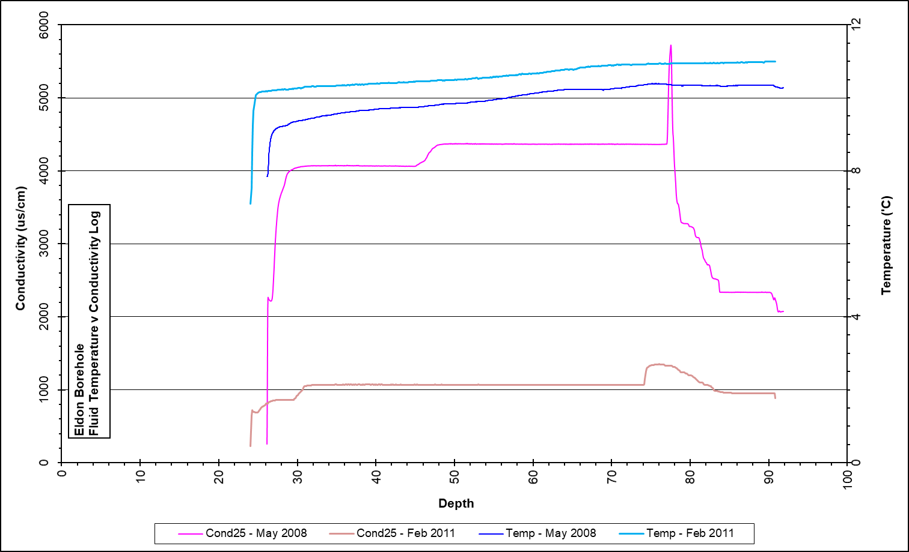
Eldon

Slide 18
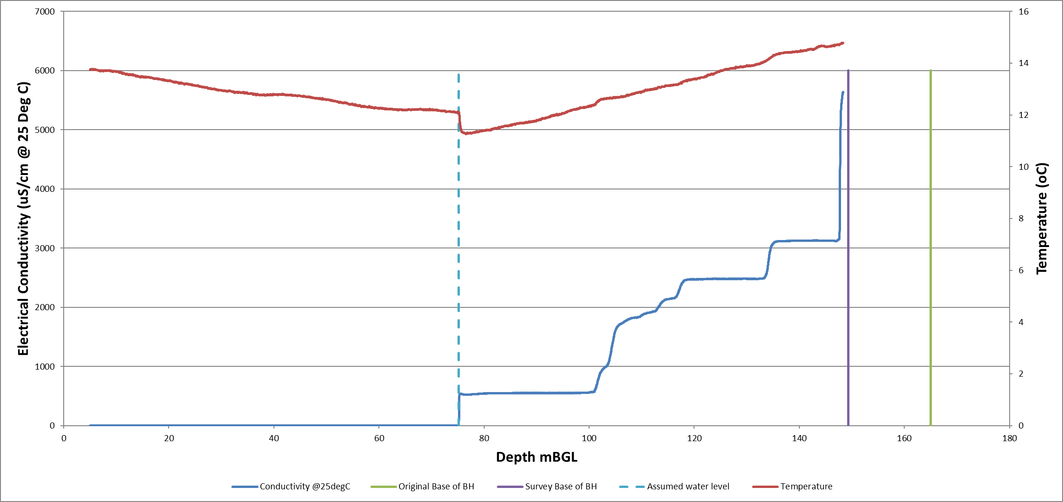
Leacroft (Monitoring BH) – 2019

Slide 19
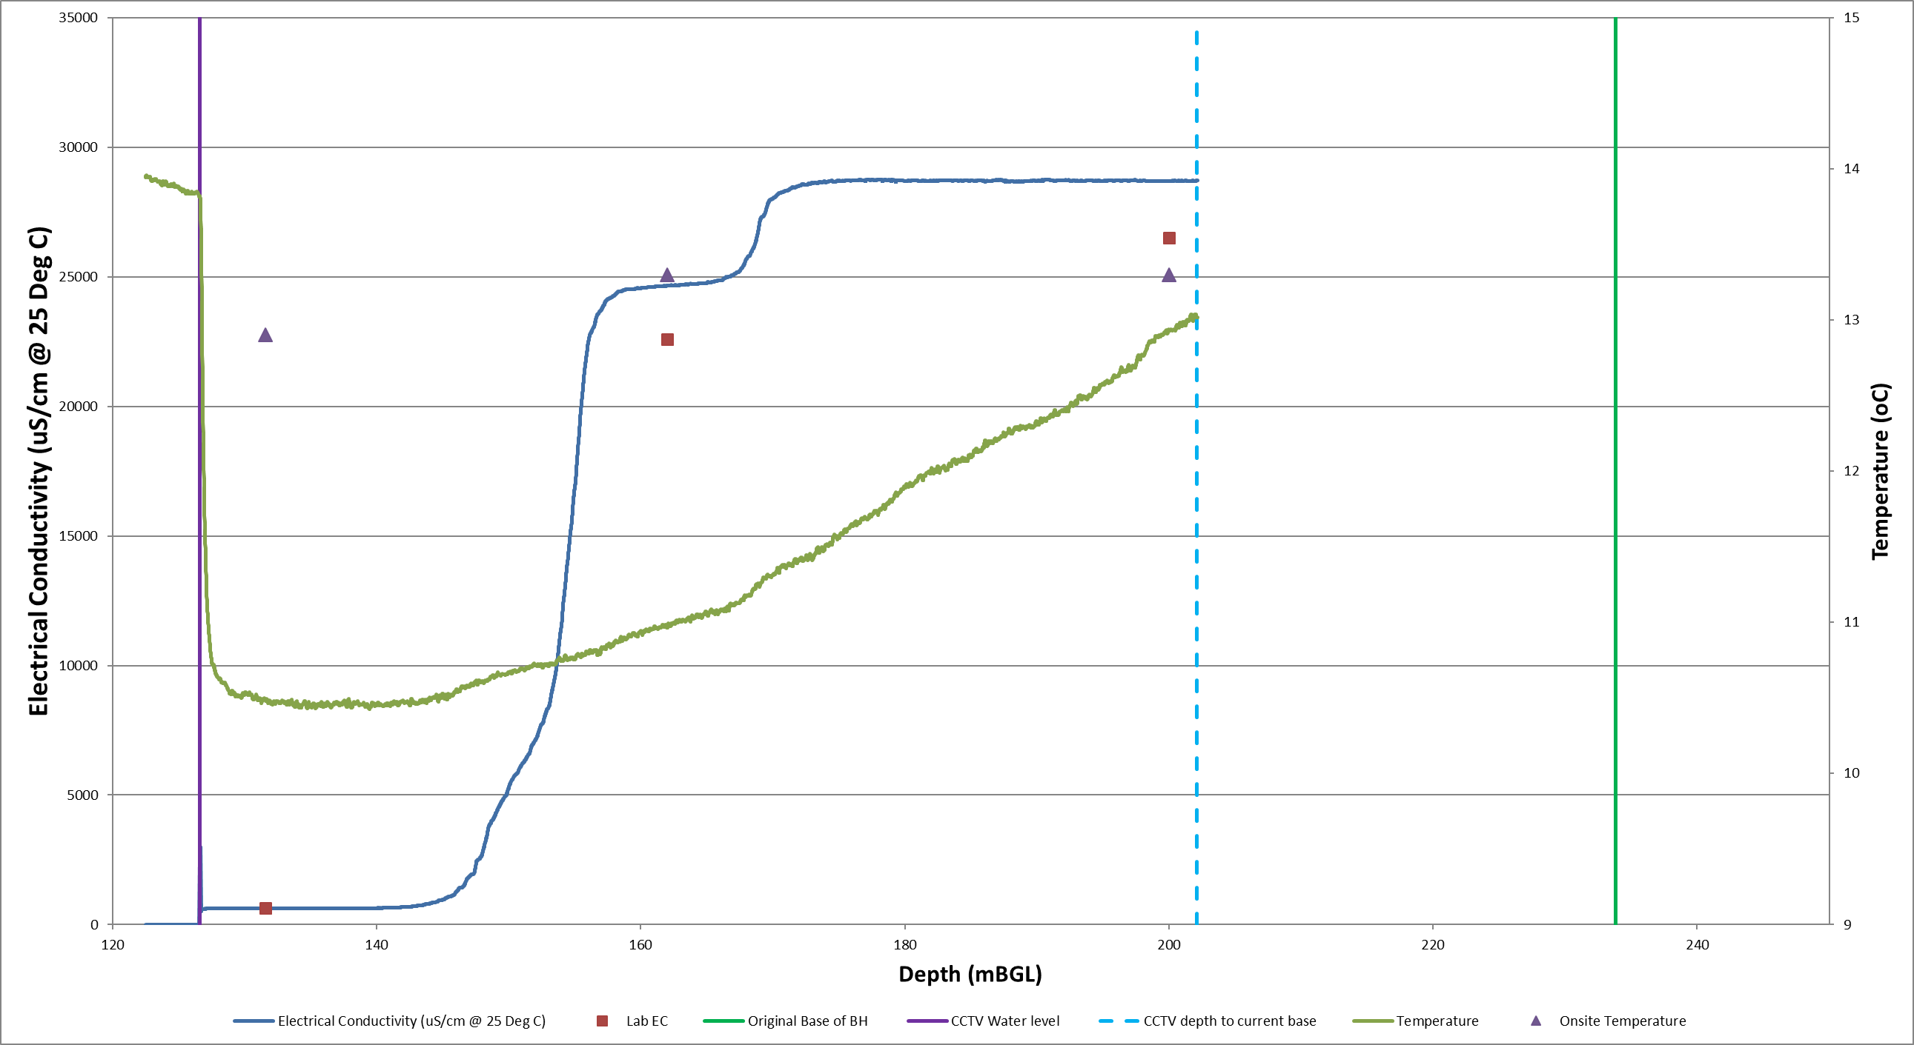
Littleton (Monitoring BH) – 2019

Slide 20
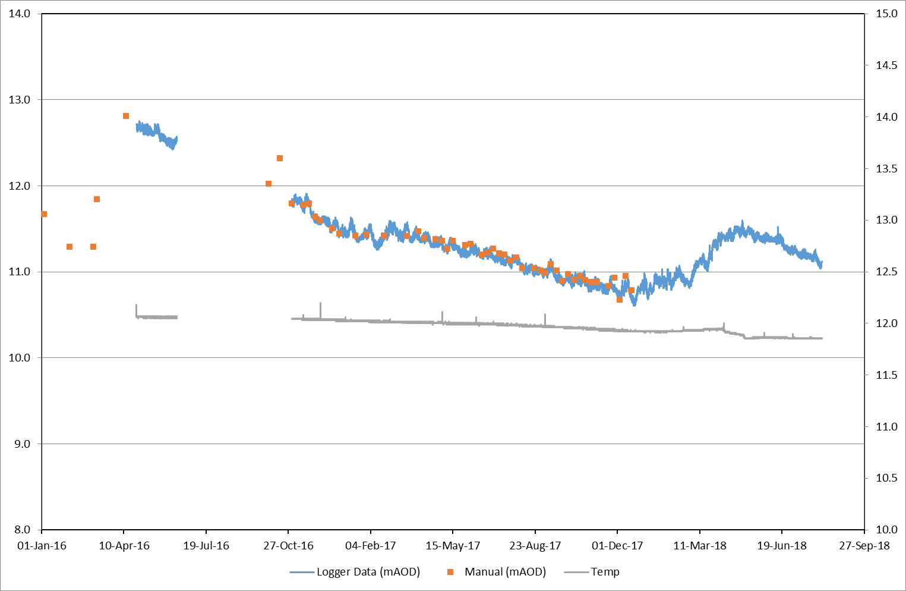
Leven 4 (Monitoring BH) – Water Level Logger

Slide 21
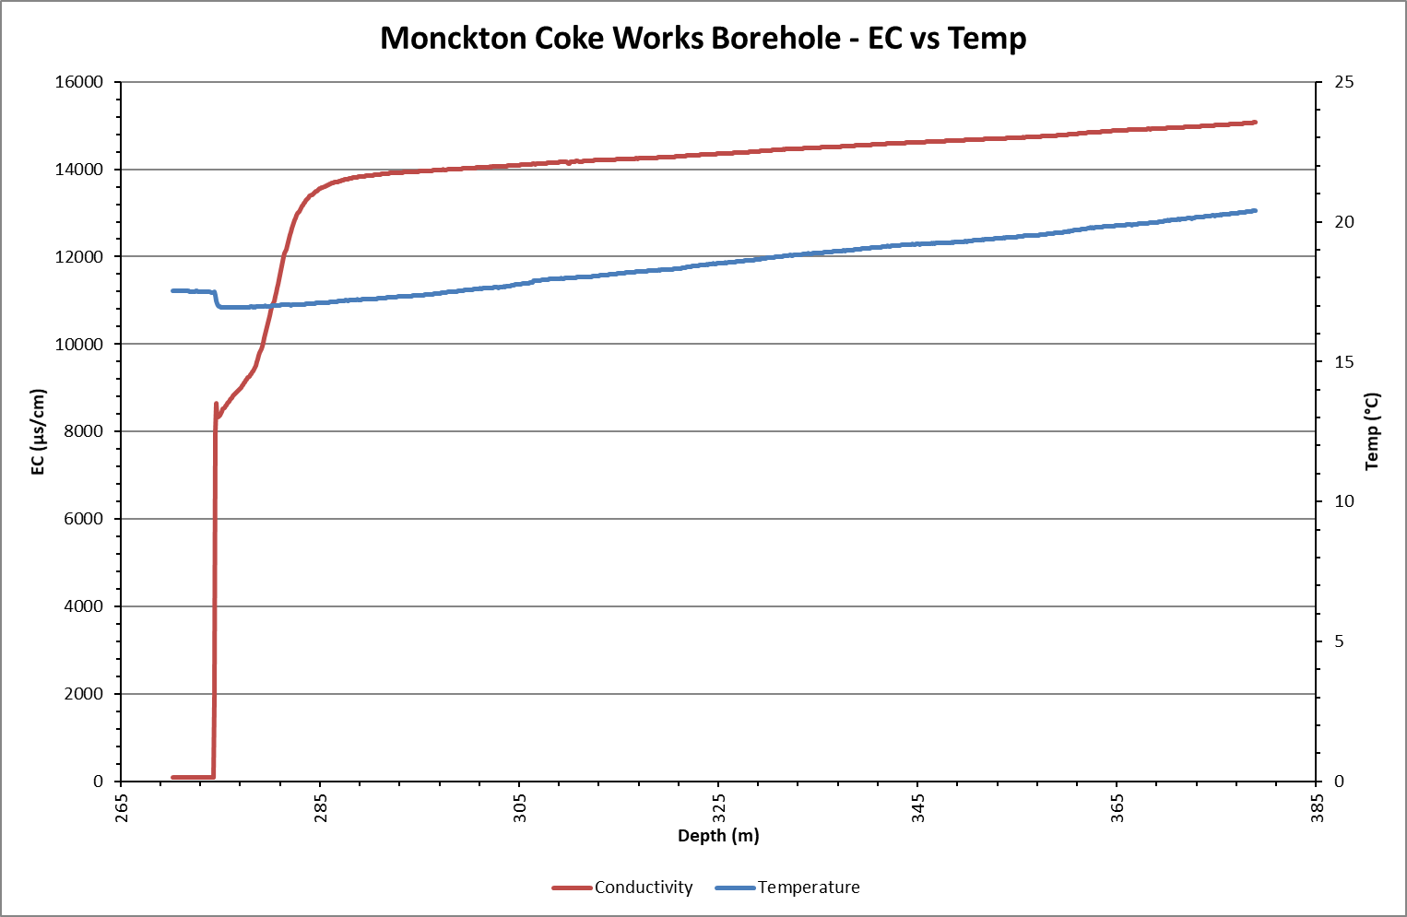
Monckton Coke Works BH ECT Log 2012

Slide 22
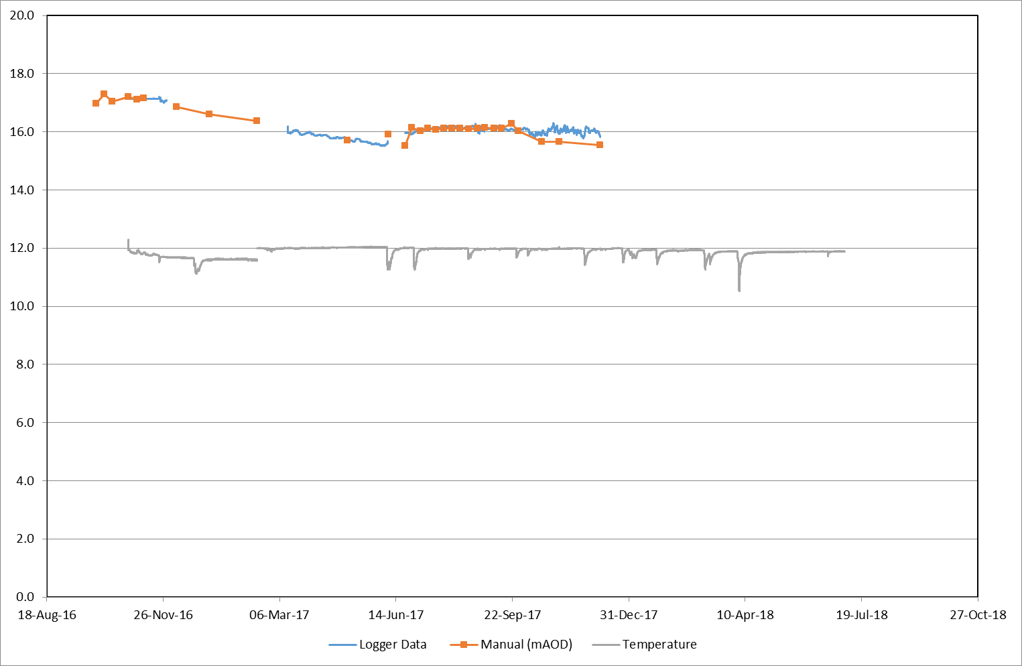
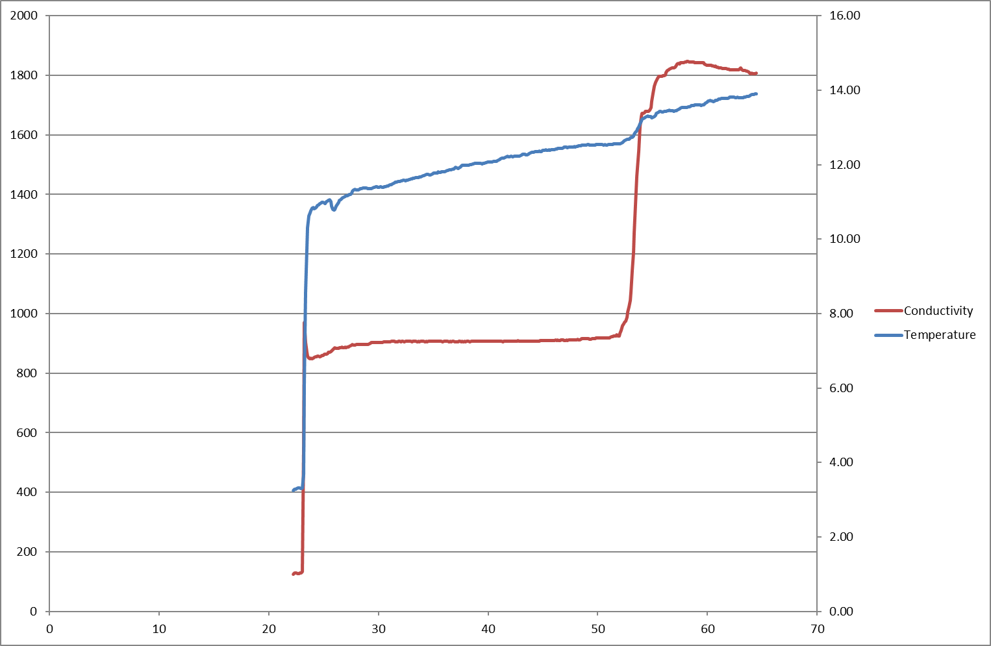
Niddrie (Wisp) BH – Water Level Logger

Slide 23
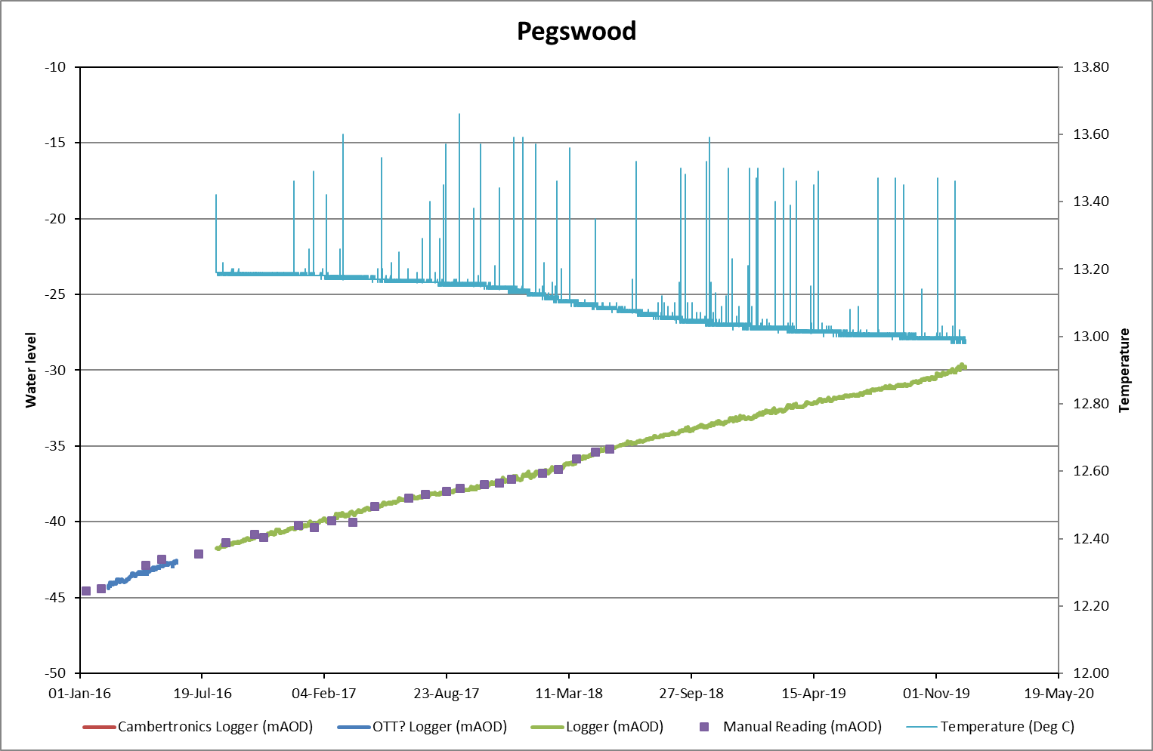
Pegswood Busty (Monitoring BH) Water Level Logger

Slide 24
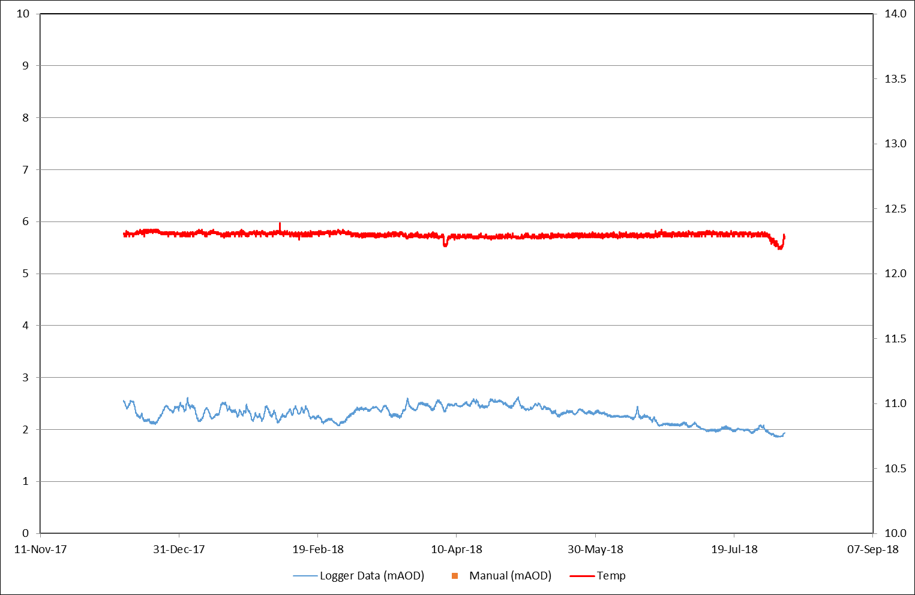
Randolph – Water level Logger

Slide 25
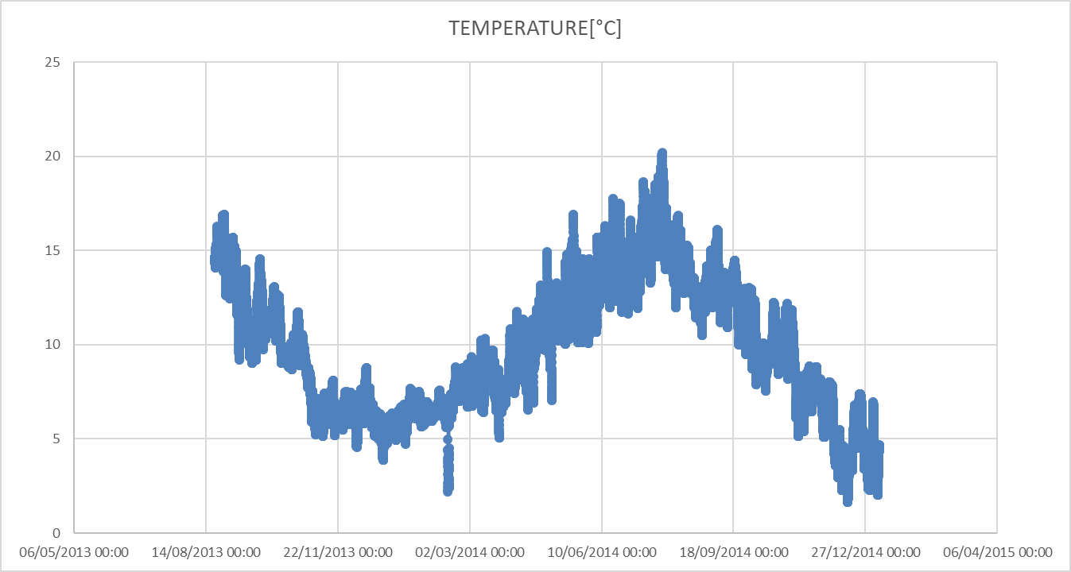
Stoney Hall – Stoney Heap
Stoney Hall Mag 2009-12 Stoney hall CM Log Stoney Heap Baro

Slide 26
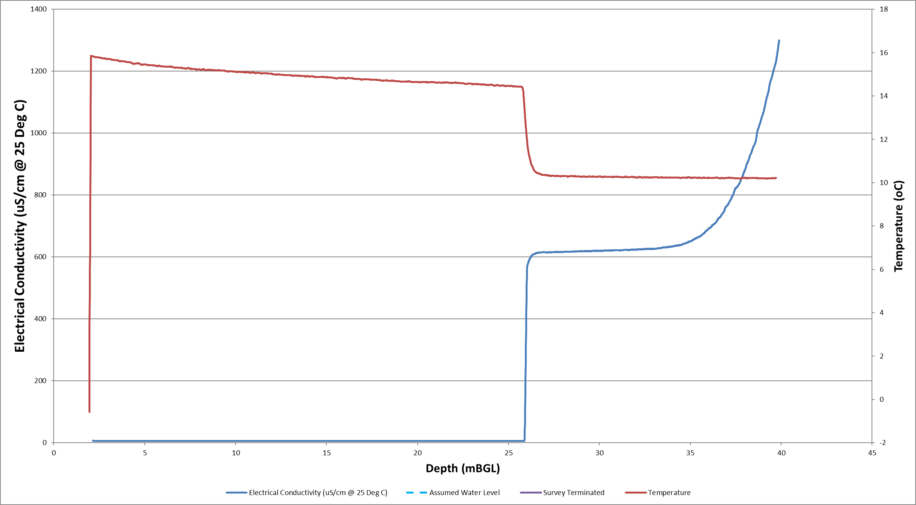
West Cannock No5 Aquifer and Seam BH - 2019
Seam Aquifer

Slide 27
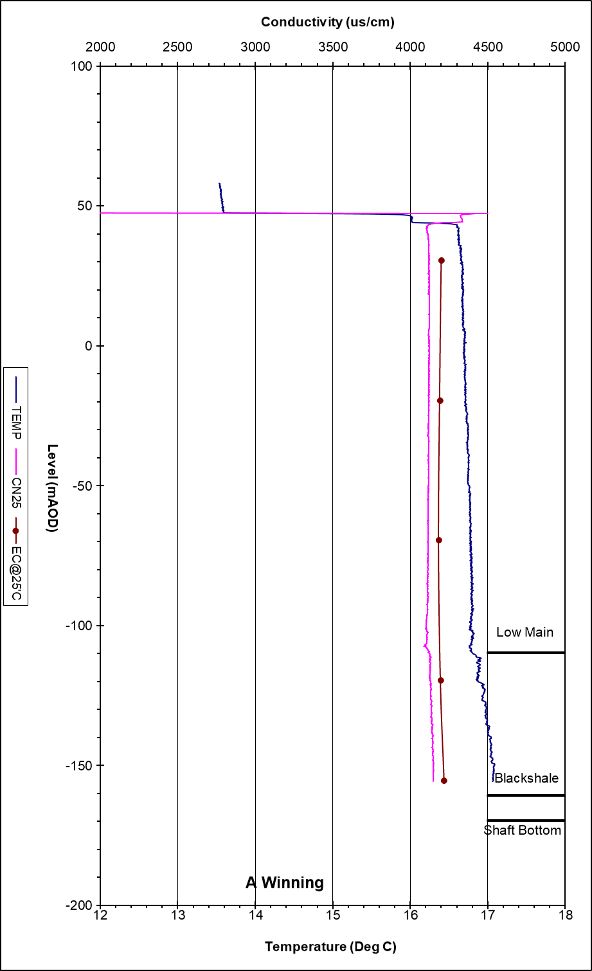
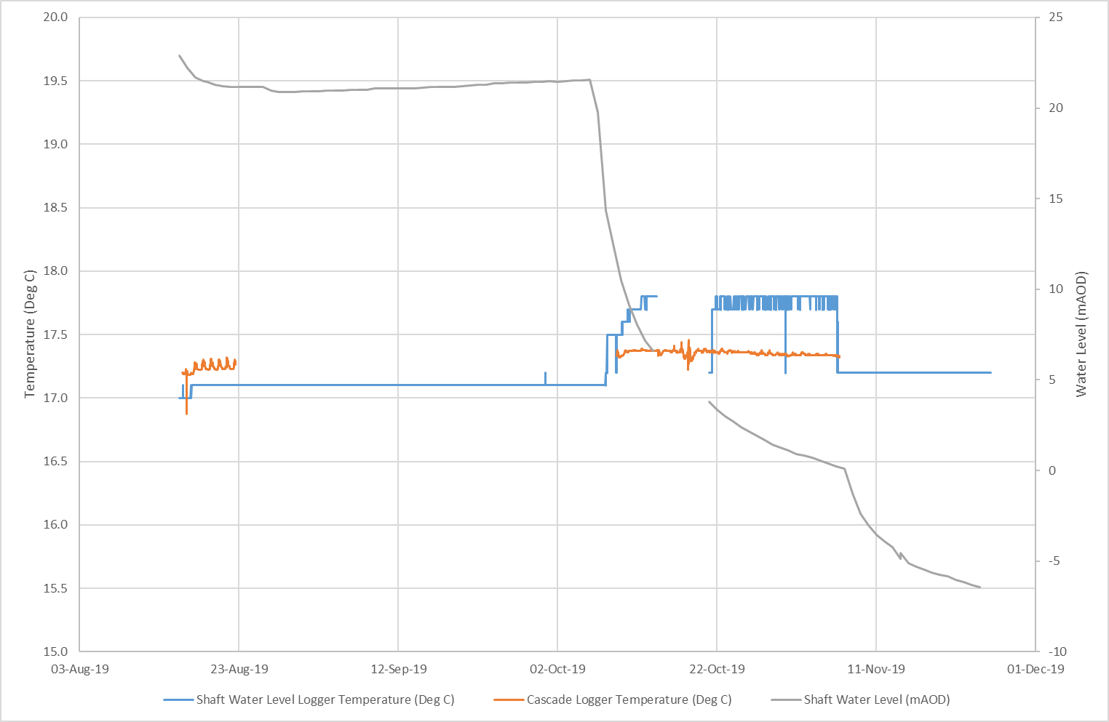
A Winning – Pumped Passive Cascade (Temperature Logger), DC shaft and Consented Discharge (Logger data)

Slide 28
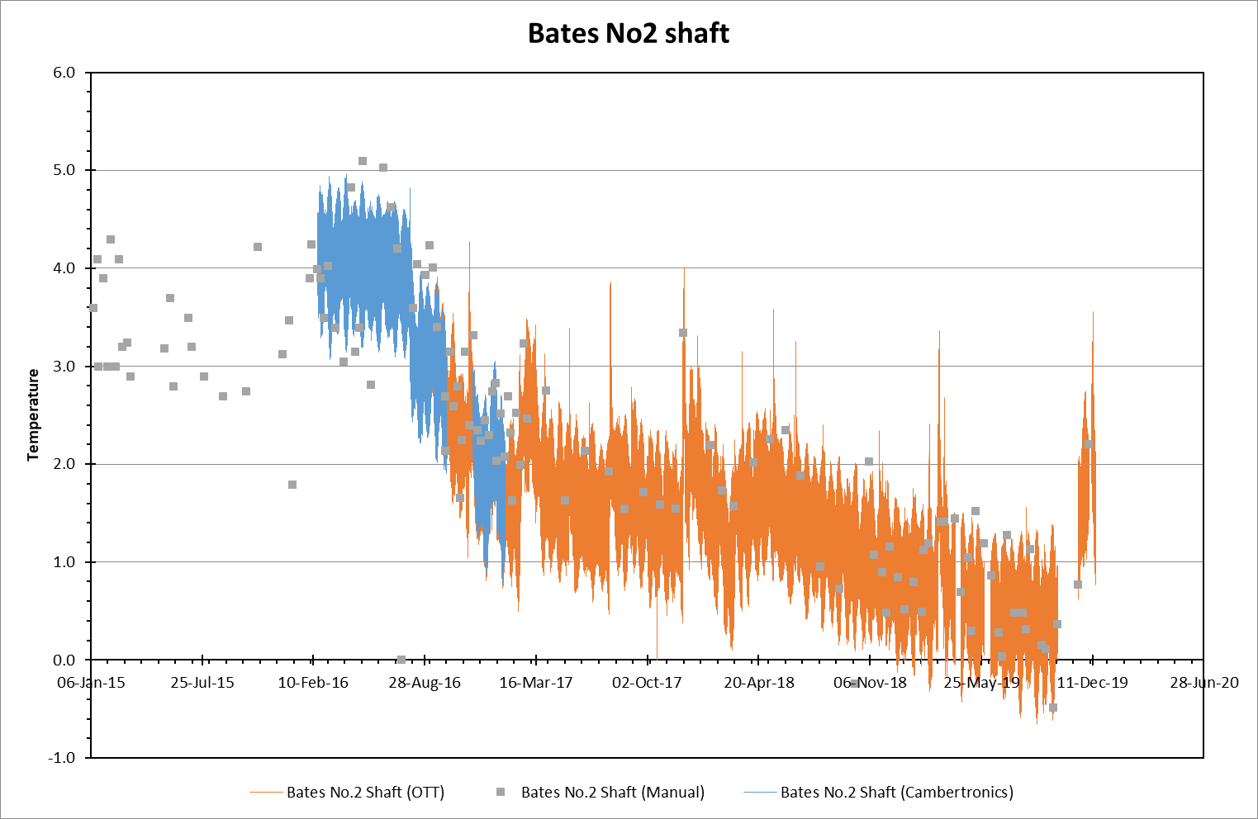
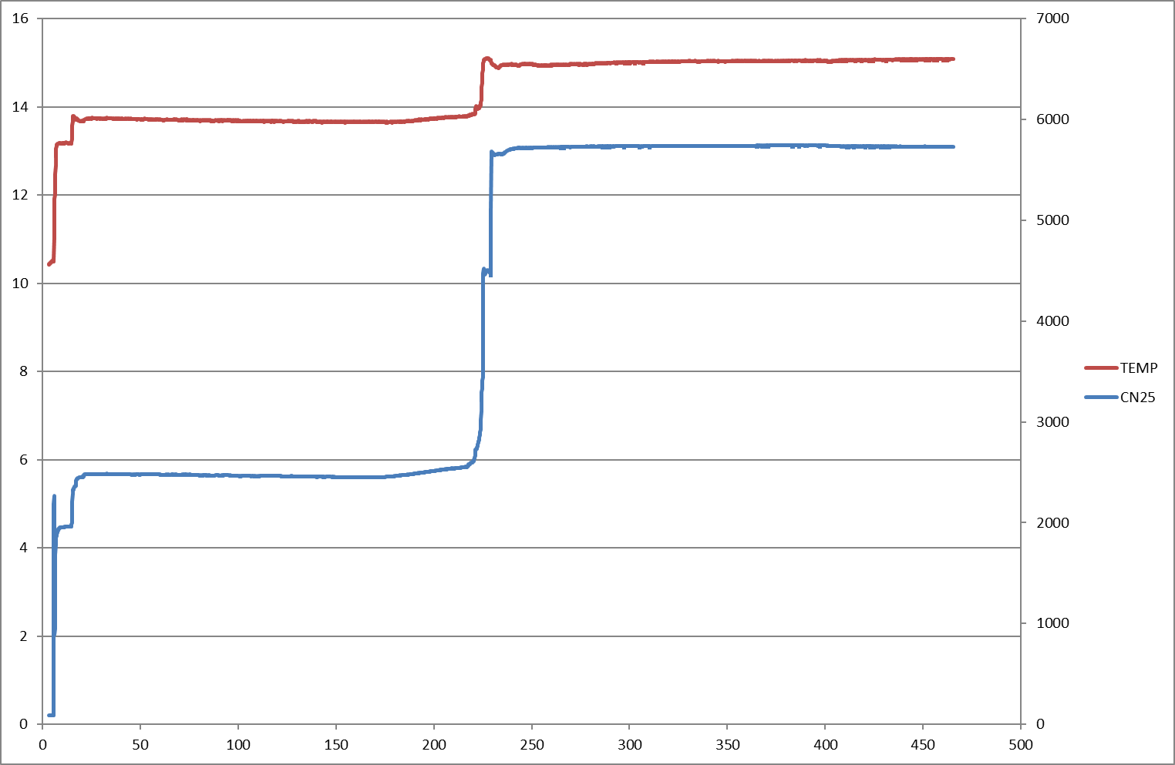
Bates Pumped - Cascade – Temperature Logger No2 shaft Log - ECT Log 2010, Water level logger No3 shaft Log - ECT Log 2010 , Water level logger

Slide 29
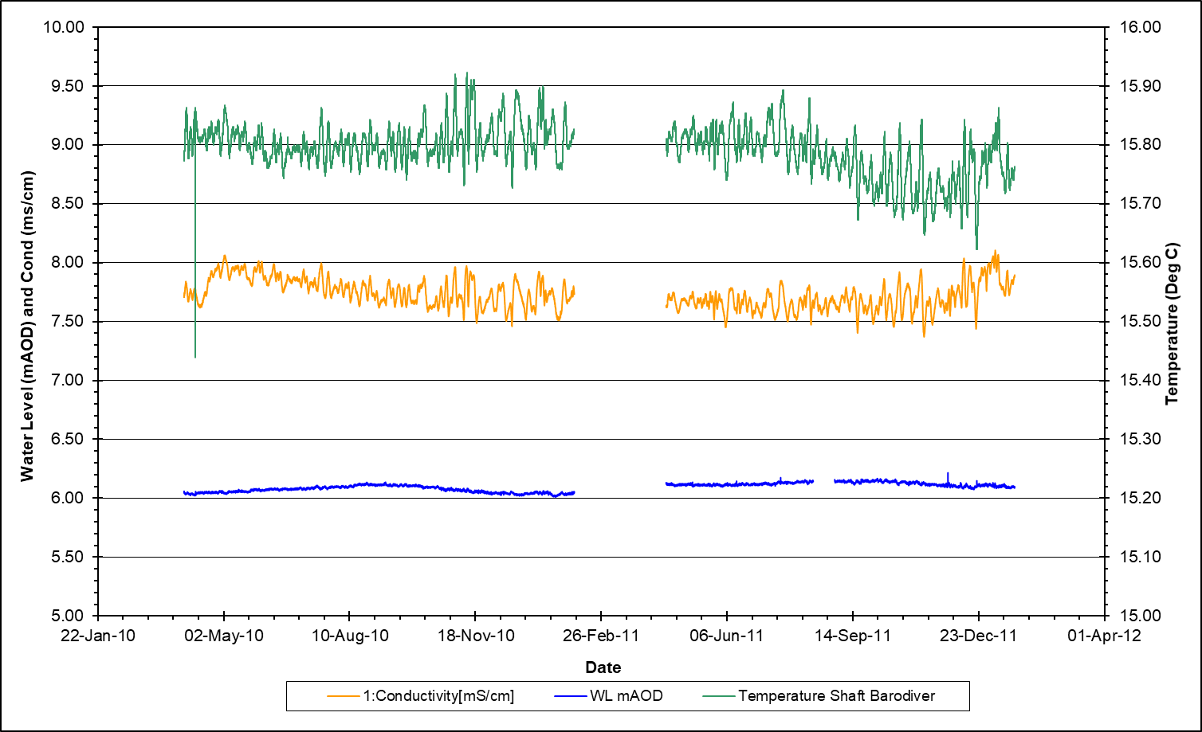
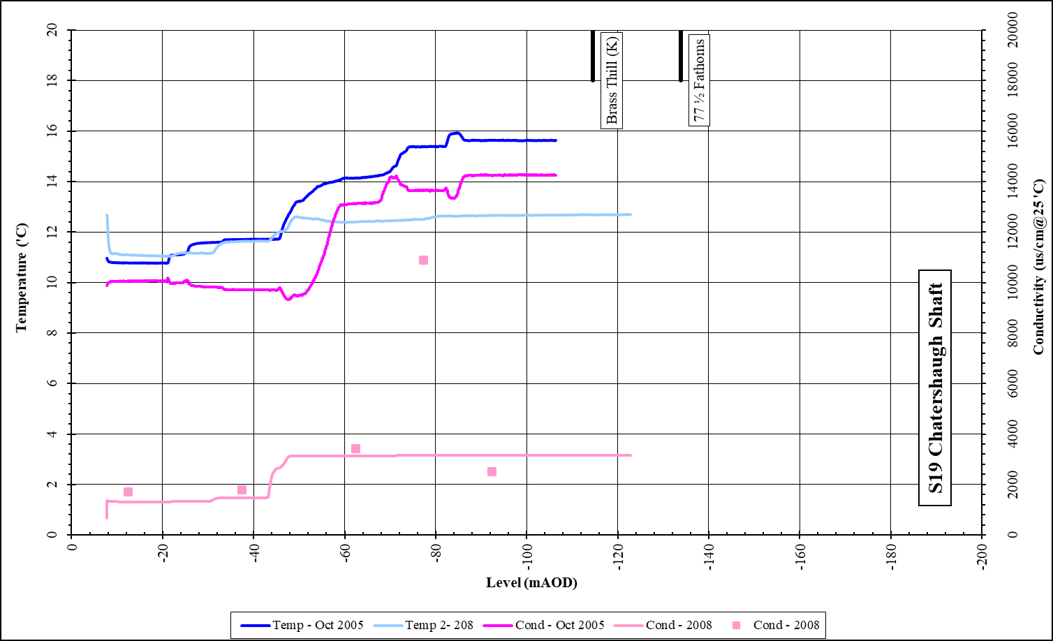
Chatershaugh

Slide 30
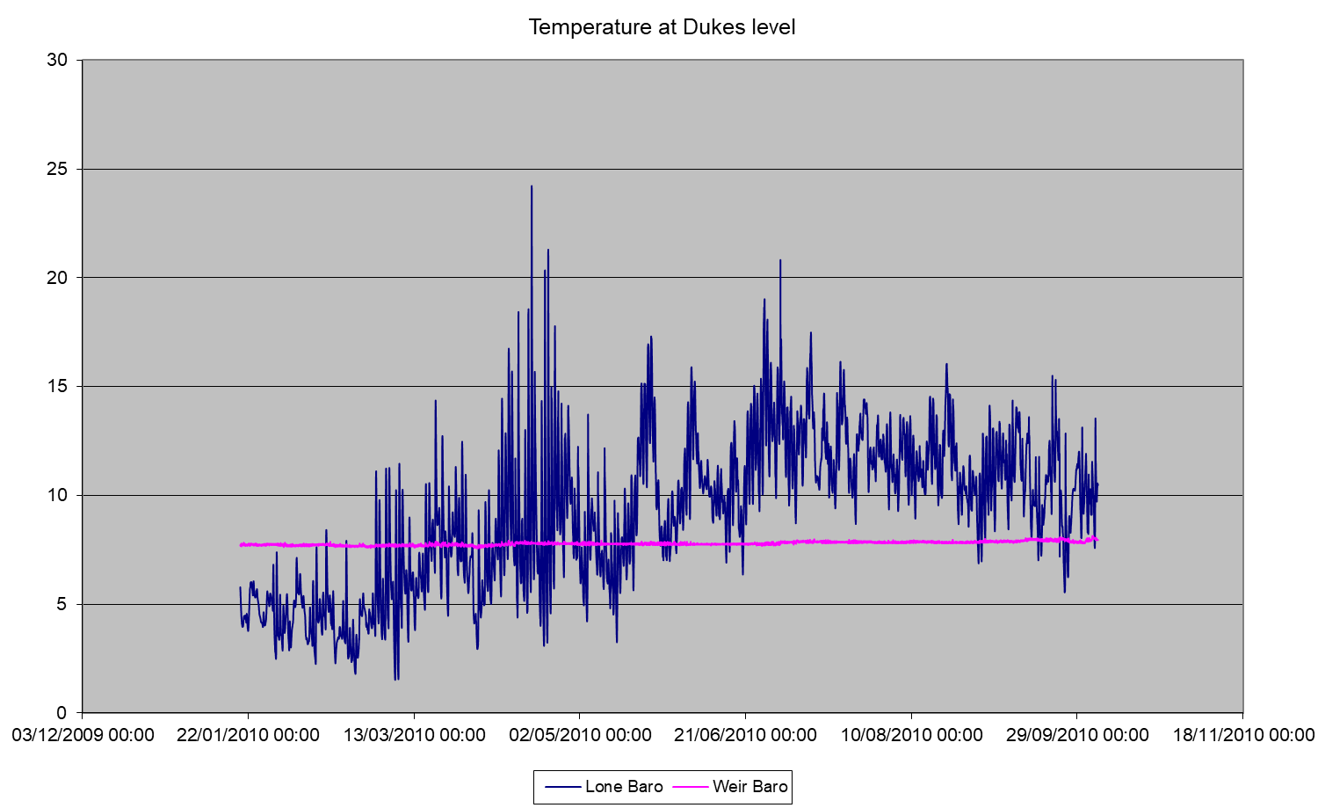
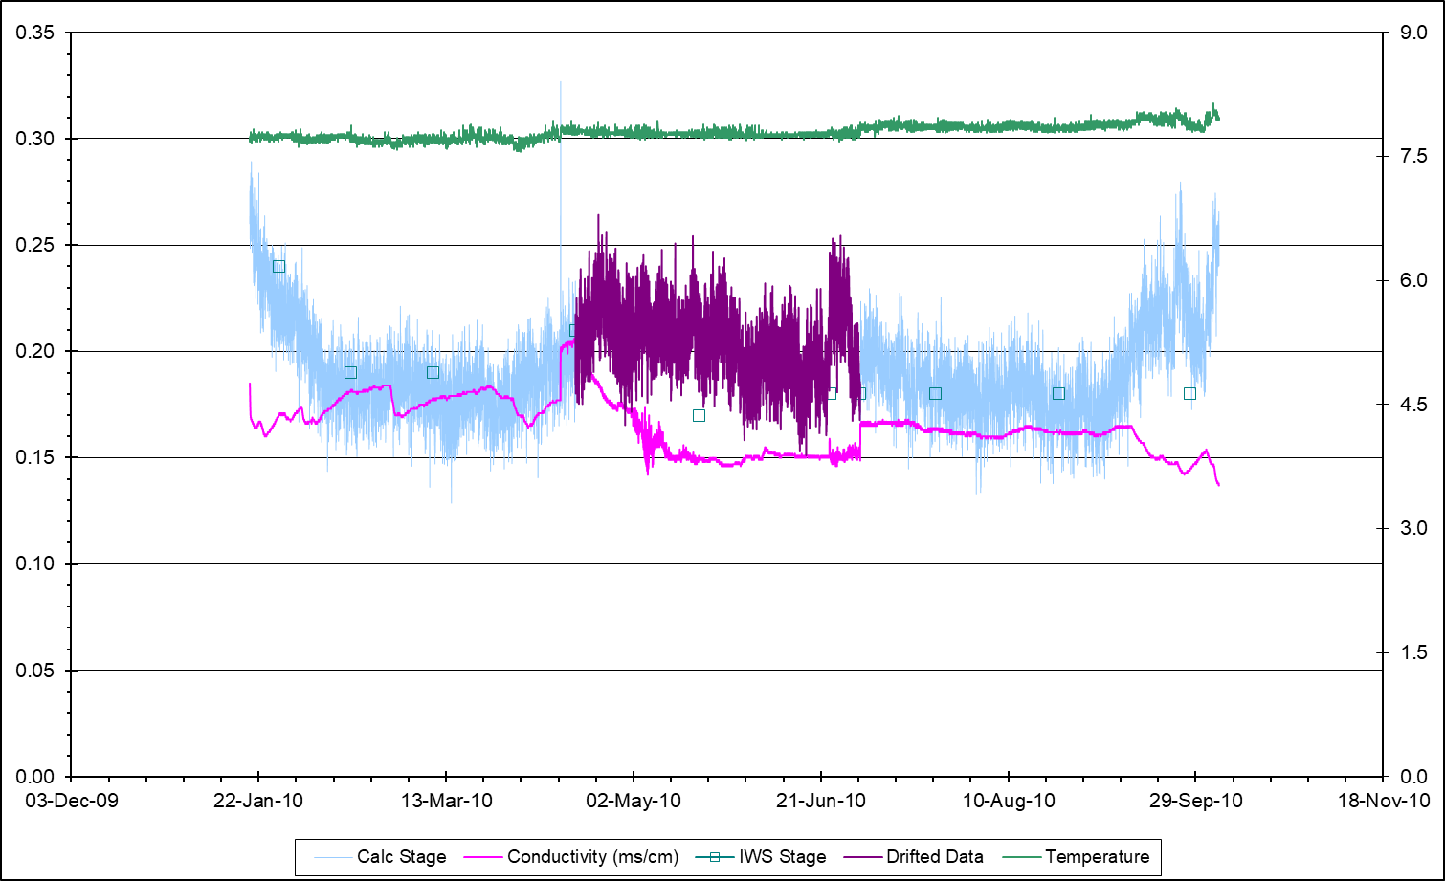
Dukes Level (discharge on surface)

Slide 31
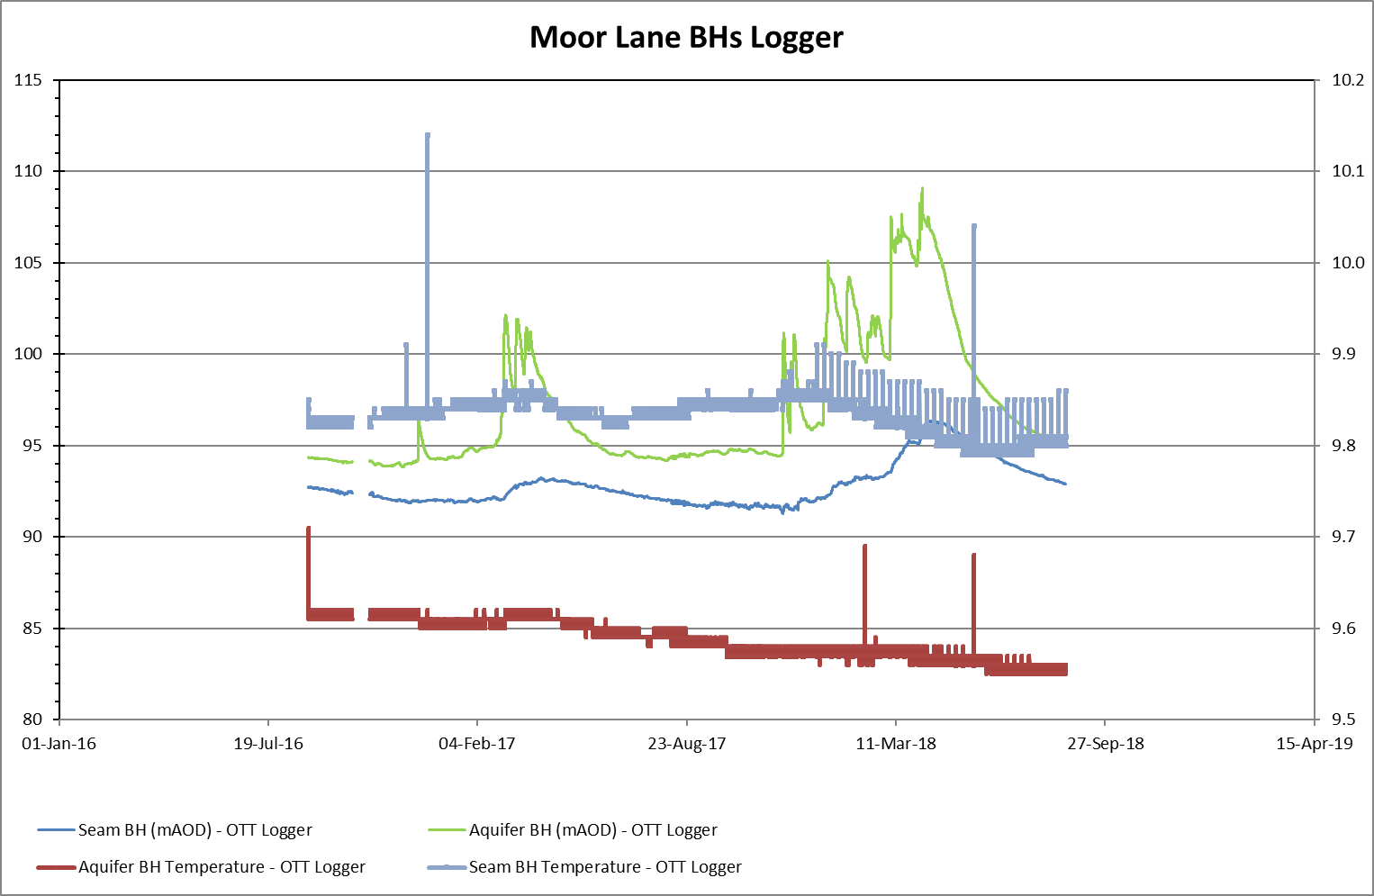
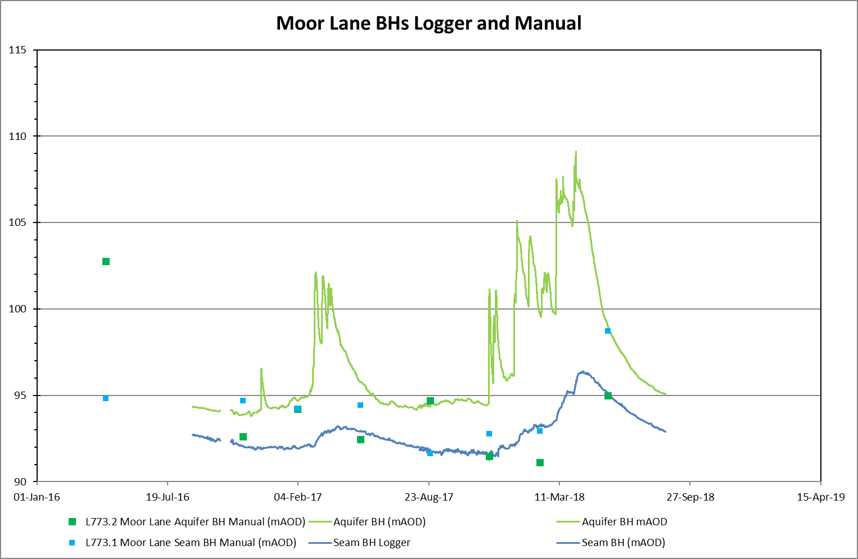
Moor Lane BH L773

Slide 32
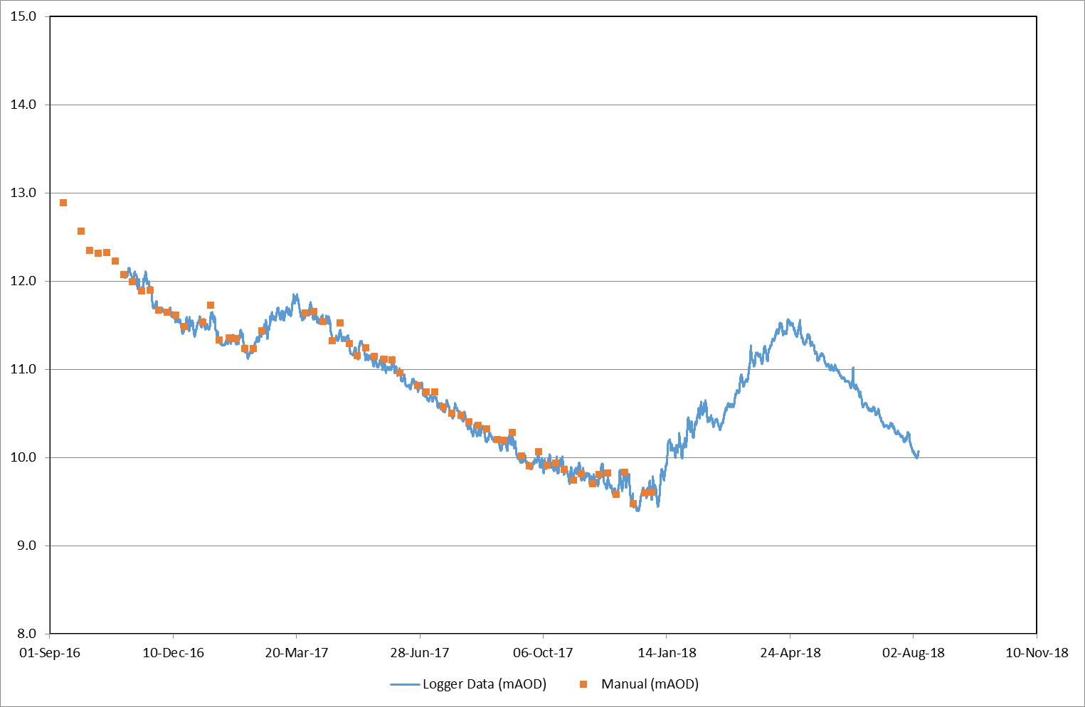
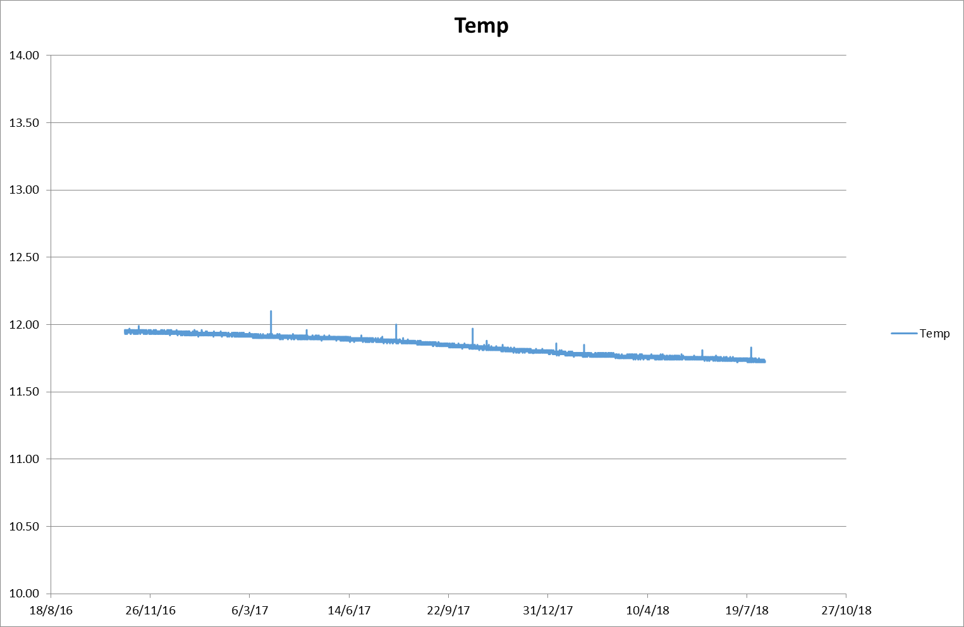
Muiredge Chemyss

Slide 33
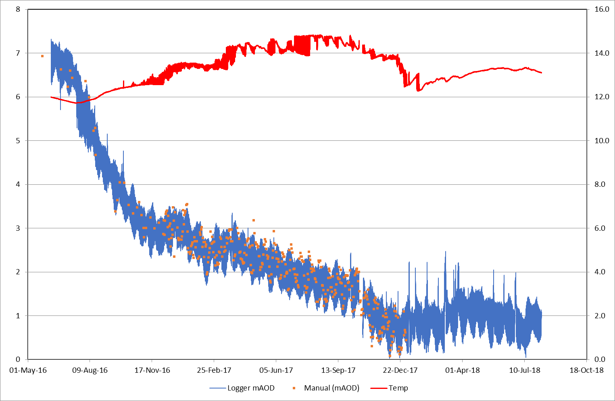
Michael logger

Slide 34
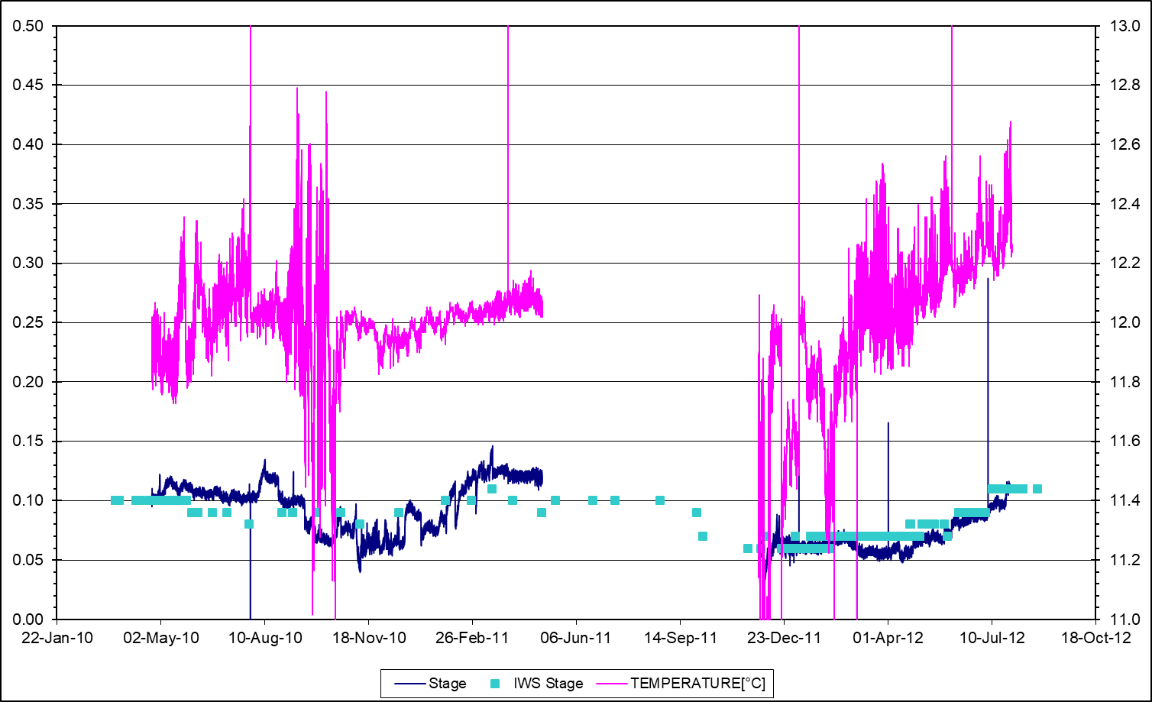
Saltersford

Slide 35
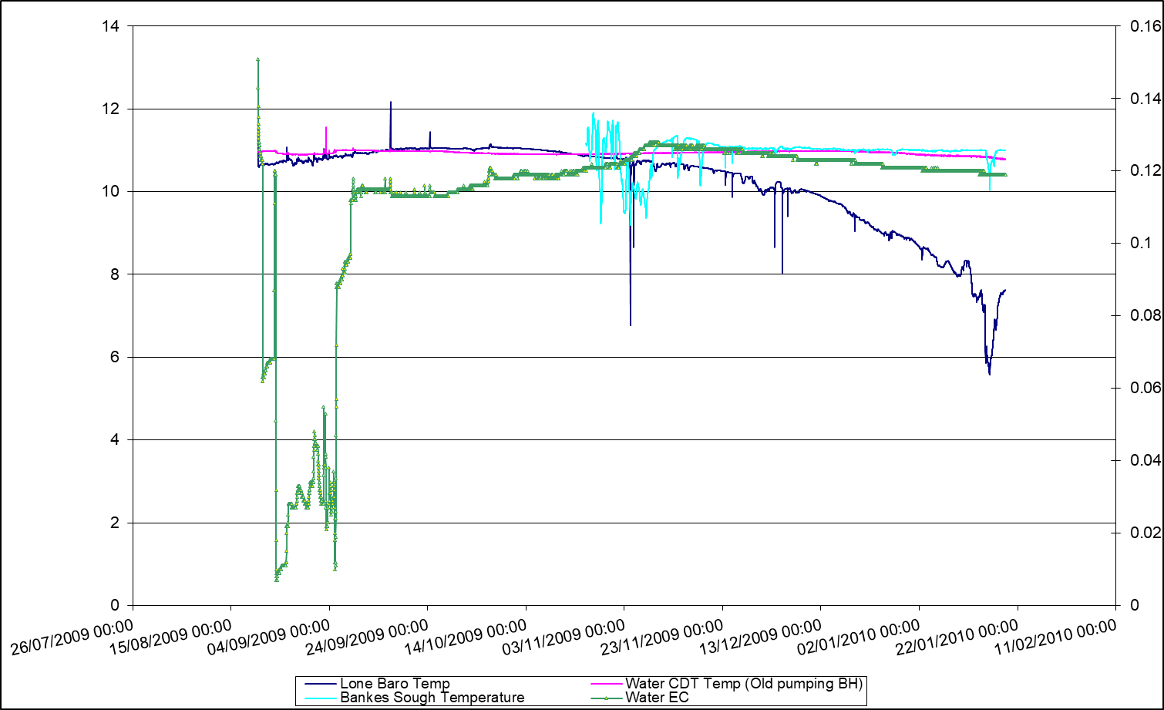
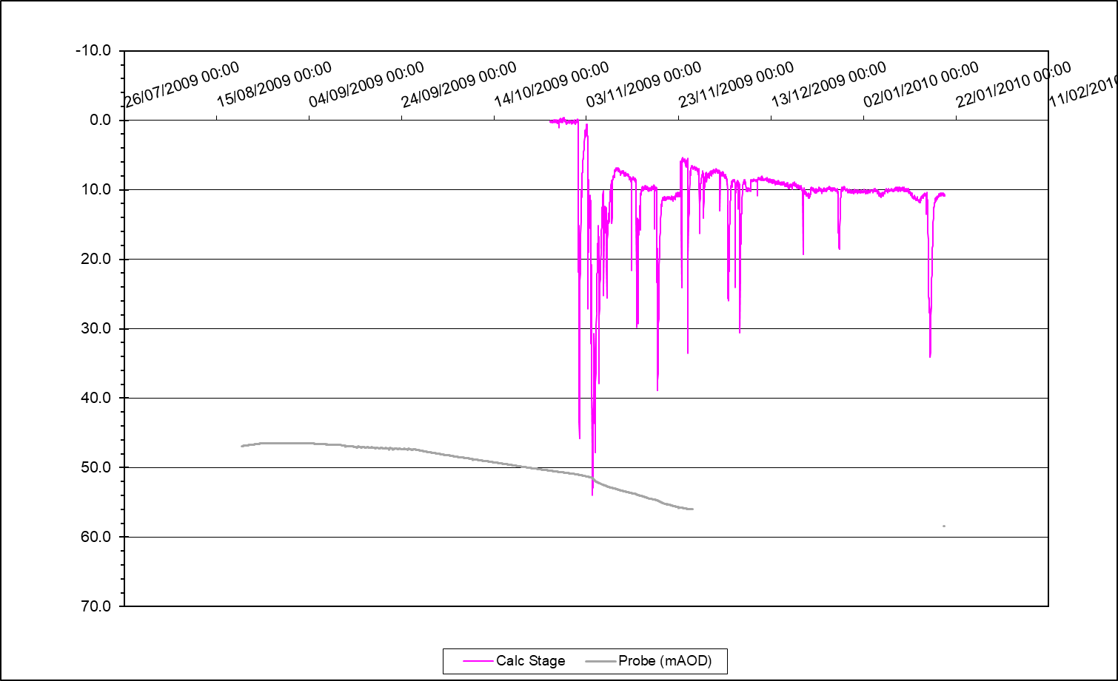
Summersales

Slide 36

Whitburn

Slide 37

Bilston Glen Shaft
Lady Victoria – MWT = 18°C – 768-788m
Burley et al., 1984
Bilson Glen shaft – MWT = 15°C – 670m
Burley et al., 1984
Notes:
Bilston glen shaft: rock T = 15°C

Slide 38



Easthouse shaft (Great Seam Borehole)

Slide 39


Easthouse and Old Fordel (Junckies) Level

Slide 40


Easthouse - Old Fordel (Junckies) Level

Slide 41


Slide 42


Dawdon
Shafts of interest: Dawdon, Horden, Hawthorn, Easington
EC-T logs during mine flooding

Slide 43

Horden Cascade (Temperature Logger) Shaft (Logger Data)

Slide 44

Horden Shaft Log (ECT Logs)
South Hetton strata temp:
19°C at 355 m

Slide 45


Slide 46




Hawthorn
17,5°C = temperature at Main G at Easington
(where Main G at 300m)
Why no step in 2003?
South Hetton strata temp:
19°C at 355 m
Notes:
Hawthorn well drilled across Main Coal G and Hutton L workings
Rouge (2000) :
- NO steap at Five Quarter Yet → water level at -120 mAOD
- step at Main G (-160m) between -150 and -160m
Step between Low Main J (about -192m) between -200 and -210m (Inset Hanging On level situated below, see LOG)
Step at coal M (‘Skip Inset Level »)
Bleu (2003): water level at -50 mAOD
Step at five Quarter / High Main E (about -110m)
step at Main G shifted to deeper (down to -165m)
No step below (temperature equilibrate?)
Violet (2005) : Same water level everywhere (-15 mAOD) + Production at Dawdon started:
- Large step between Five Quarter E and Main G (profile tends to average min/max temperatures)
Small step between Low Main J and Inset
Vert (2006): water level at – 8mAOD
Large step at Five Quarter shifter toward higher temperatures
For all profiles, step at Harvey get more pronounced with time toward lower temperatures
During flooding, temperatures are relatively hot in average and follow the geothermal gradient (red profile), with a step at each inset/worked coal bed
Once flooding is completed, upper part of the profile tends to get warmer as the step gets deeper. Below that step, the profiles tends to get colder. If no production is performed, it is expected that isotemperature is reached as the number of small step decreases in favour of larger amplitude of the remaining big step at about -150 and -300m (homogeneous temperatur ebetween those large steps).
Surface temperature: 12°C – is it in accordance with geothermal gradient?
Strata temp indicates 23°C at 450 m depth near Hawthorn → red curve approximately follows this gradient up to the low Main. Above that, cold water recharges the system.
Recently, a pumping rate increases, temperature decreases (because colder temperature from surface reach logger?)
Check if this can be validated:
Temeprature profile 2003 (blue)
Bottom of isothermal profile section (i.e. -300m) = temperature of the normal temperature gradient
Top (i.e. -150 m): temperature of the connection = Main G as a temperature of 17.5°C at easington ? Why this step cannot be seen in 2000? (red profile) → maybe as wanter level too low in one of the mine section.
Compare mAOD vs mBGL

Slide 47


Easington
17,5°C = temperature at Main G at Hawthorn
South Hetton strata temp:
19°C at 355 m
Notes:
High main E, Hutton L, low main J, connected to Horden, Dawdon, Hawthorn
Main (yard) G connected to Dawdon, Hawthorn and South Hetton

Slide 48



Slide 49








L : -242 m at well
J : -160 m
N : -300 m at well
J : -192 m

Slide 50








Slide 51


